Slide 1
COMPLEMENTARY SCUTOIDS
Authors: Eva Brumat, Samo Fučka, Domen Vovk
Diocese Grammar School Vipava, 2019

Slide 2
Abstract
At the end of July 2018, researchers from the University of Seville and Lehigh University (USA) published an article titled »Scutoids are a geometric solution to three-dimensional packing of epithelia«. The solution to the problem of packing epithelia cells in curved shapes was the discovery of a new geometric shape – the scutoid. The scutoid is a solid similar to the prism, whose base surfaces are two different parallel n-gons, the side edges are line segments or some other suitable curves of which at least two form the connection in the shape of the letter Y. That is necessary because of the different number of vertices in the base surfaces. The surfaces of the scutoid can be curved, which enables them to be used for the modelling of the way cells in the epithelial tissues connect.
In our research project, scutoids were observed in spaces between two parallel planes and were analysed from mathematical aspects. The definition was limited to those scutoids whose basic surfaces are the correct polygons with n and n + 1 vertices, which are connected with line segments. We searched for those scutoids which supplement each other in pairs alongside the surfaces surrounding Y. In the sources available, the only scutoid described is the one with a pentagon and a hexagon as its base surfaces, which we named the complementary 5-6 scutoid. The aim of the research project was to design and analyse the complementary 5-6 scutoid. In addition, two other scutoids were constructed, the complementary scutoid 4-5 and the complementary scutoid 3-4. Their properties were described and the way in which they connect in pairs was researched.
Key words: scutoid, scutellum, space packing, epithelia.
Slovenian original: http://sgv.splet.arnes.si/files/2018/06/Dopolnjujo%C4%8Di-se-skutoidi.pdf

Slide 3
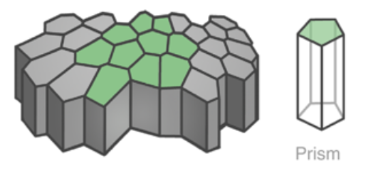
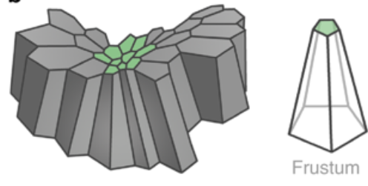
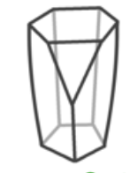
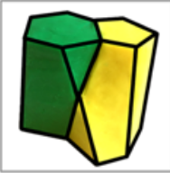
INTRODUCTION= CHALLENGE
»Scutoids are a geometric solution to three-dimensional packing of epithelia« (https://www.nature.com/articles/s41467-018-05376-1). Journal: Nature, July 27th 2018

Slide 4
Name?
Bugs Cetoniidae have
scutellum

Slide 5
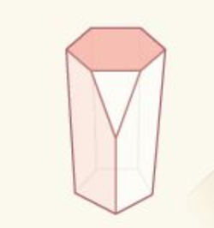
The definition of scutoid
The scutoid is a solid similar to the prism, whose base surfaces are two different parallel n-gons, the side edges are line segments or some other suitable curves of which at least two form the connection in the shape of the letter Y. The surfaces of the scutoid, except the base and scutellum, can be curved.

Slide 6
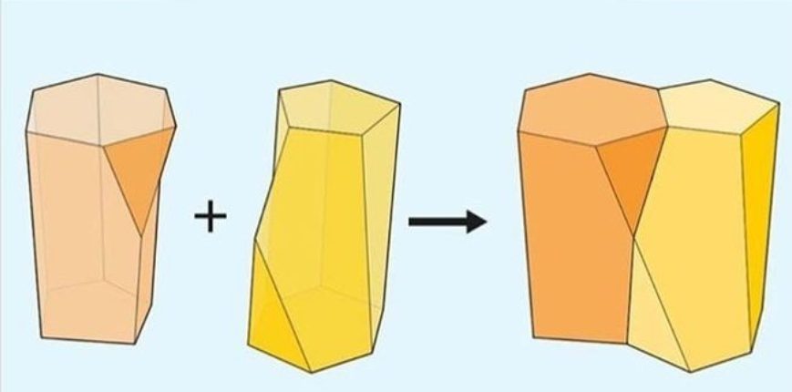
Aims:
to design the complementary 5-6 scutoid
to describe the properties of the scutoid
to design the complementary scutoid 4-5 and 3-4
to put forward as many problems as possible and find solutions for them

Slide 7
Methods:
work according to the original article and internet sources
forming hypotheses using 3D models, constructed in programme SOLIDWORKS and printed by 3D printer
mathemathical calculations and proving the hypotheses

Slide 8
RESULTS:

Slide 9
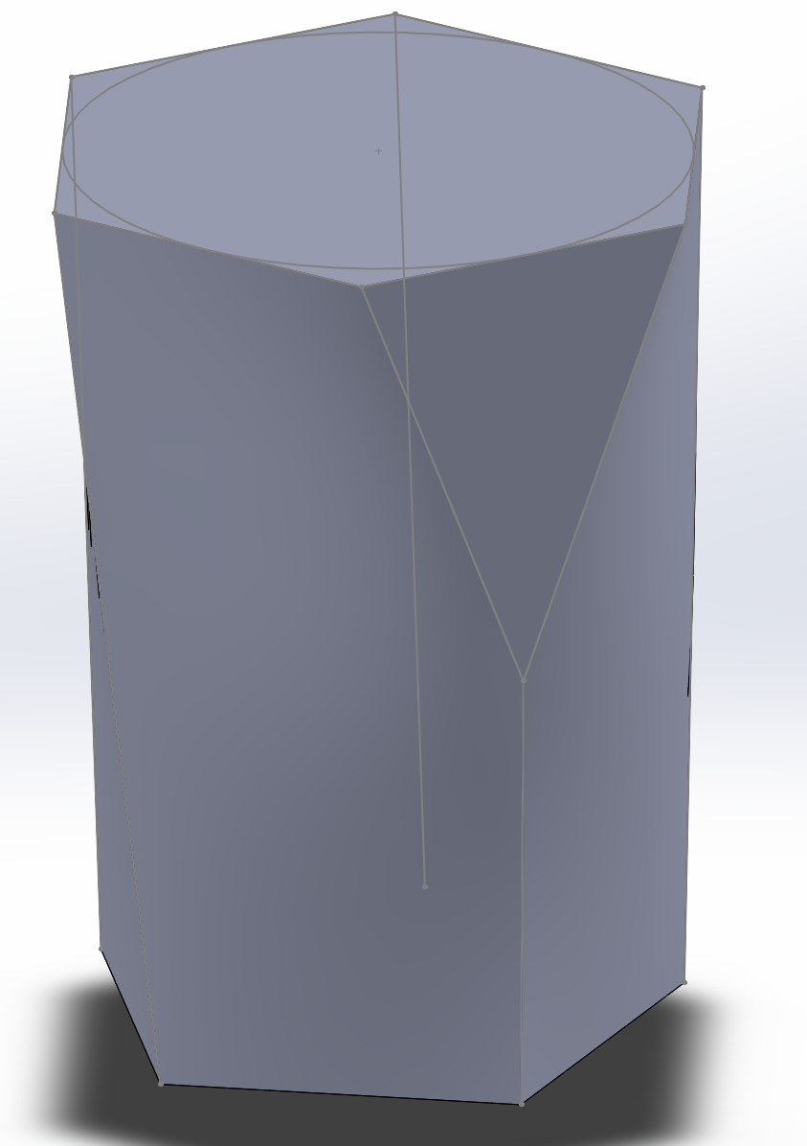
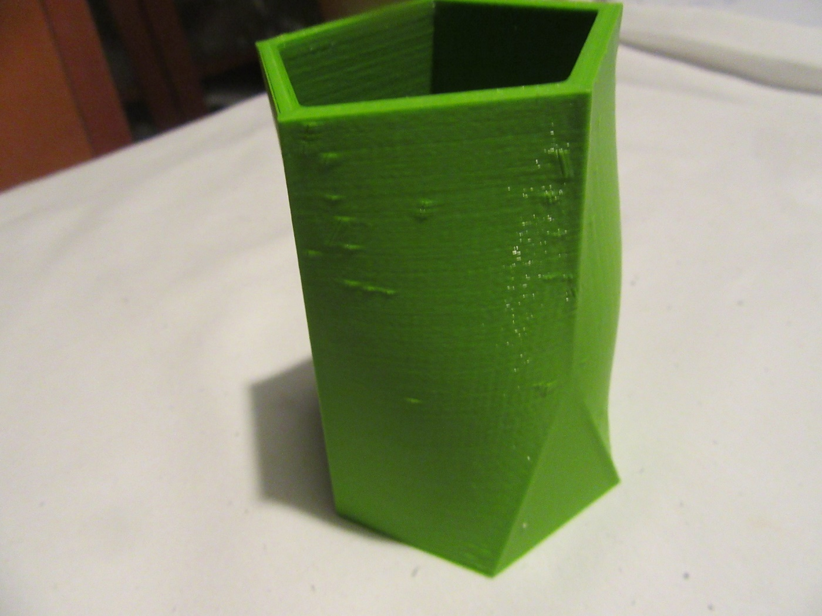
ORDINARY SCUTOID 5-6

Slide 10
Ordinary scutoid 5-6 – properties:
legsY lie in the same plane,
it does not supplement each other in pairs alongside the surfaces surrounding Y.

Slide 11
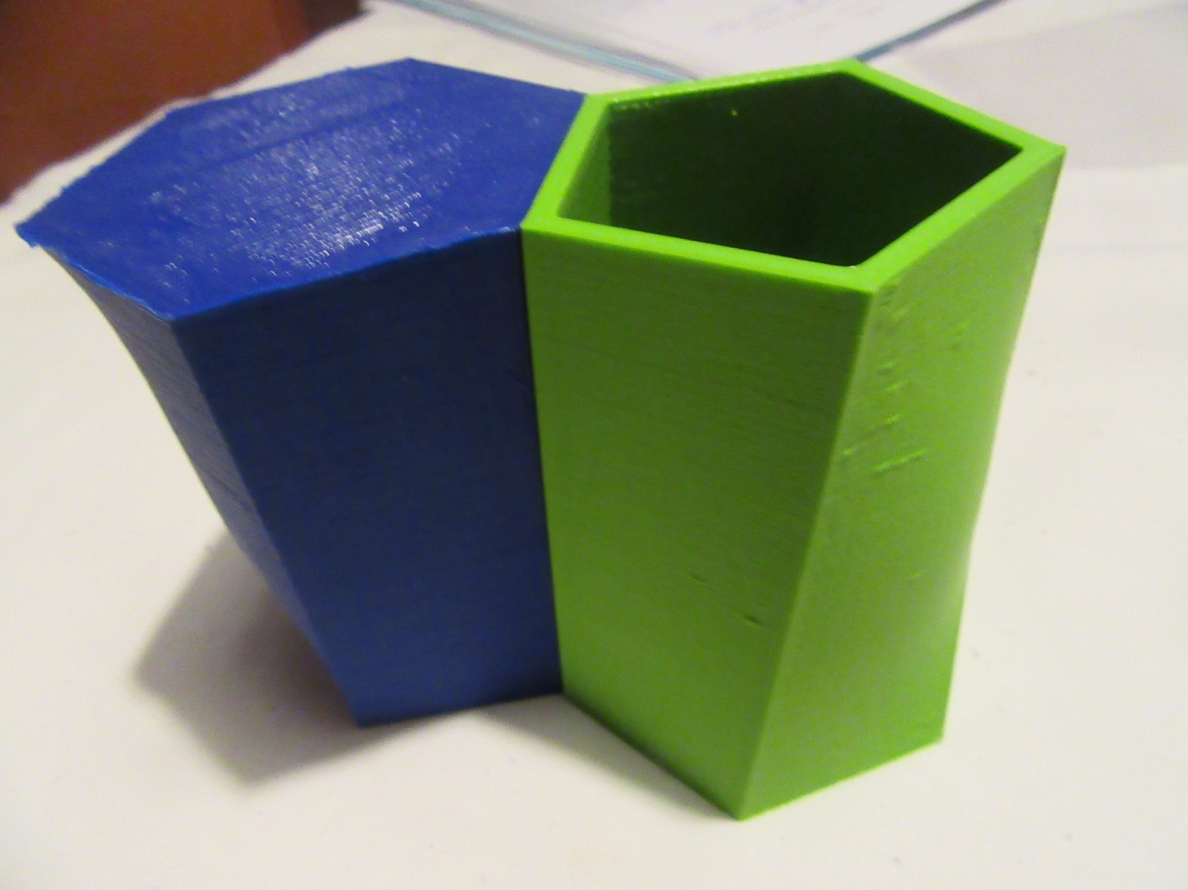
Ordinary scutoid 5-6 – connecting1x

Slide 12
Complementary scutoid 5-6
(Pair of Packable scutoids)

Slide 13
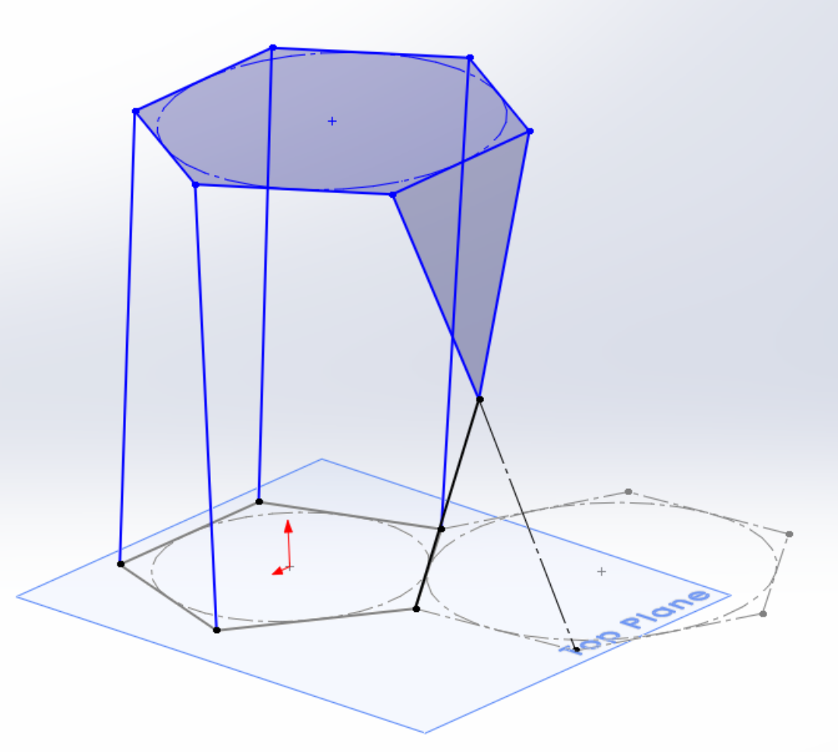
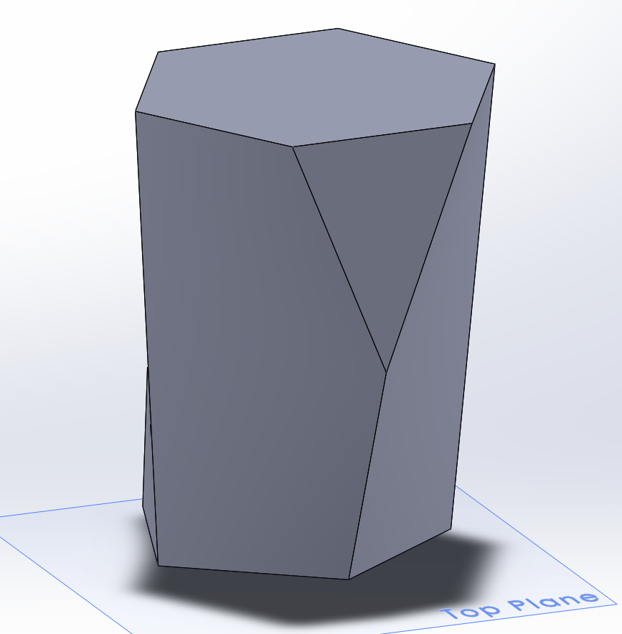
Complementary scutoid 5-6: construction

Slide 14
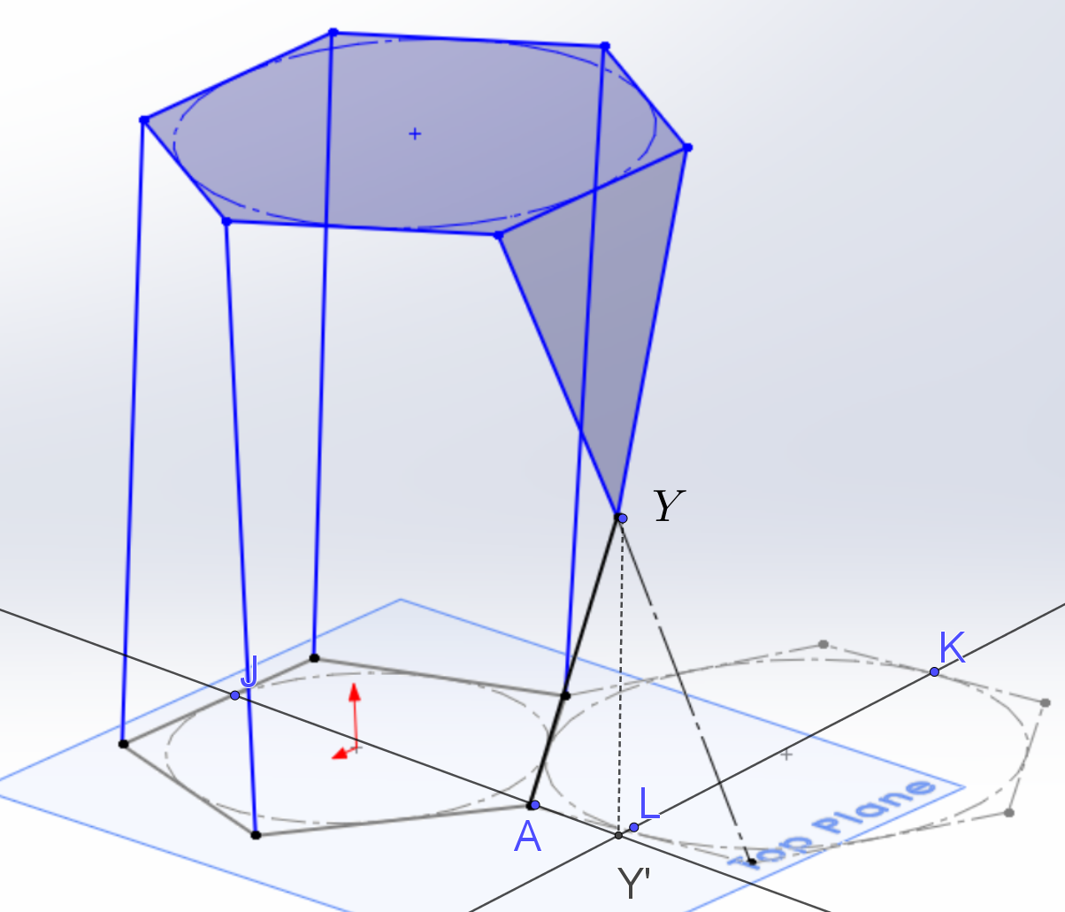
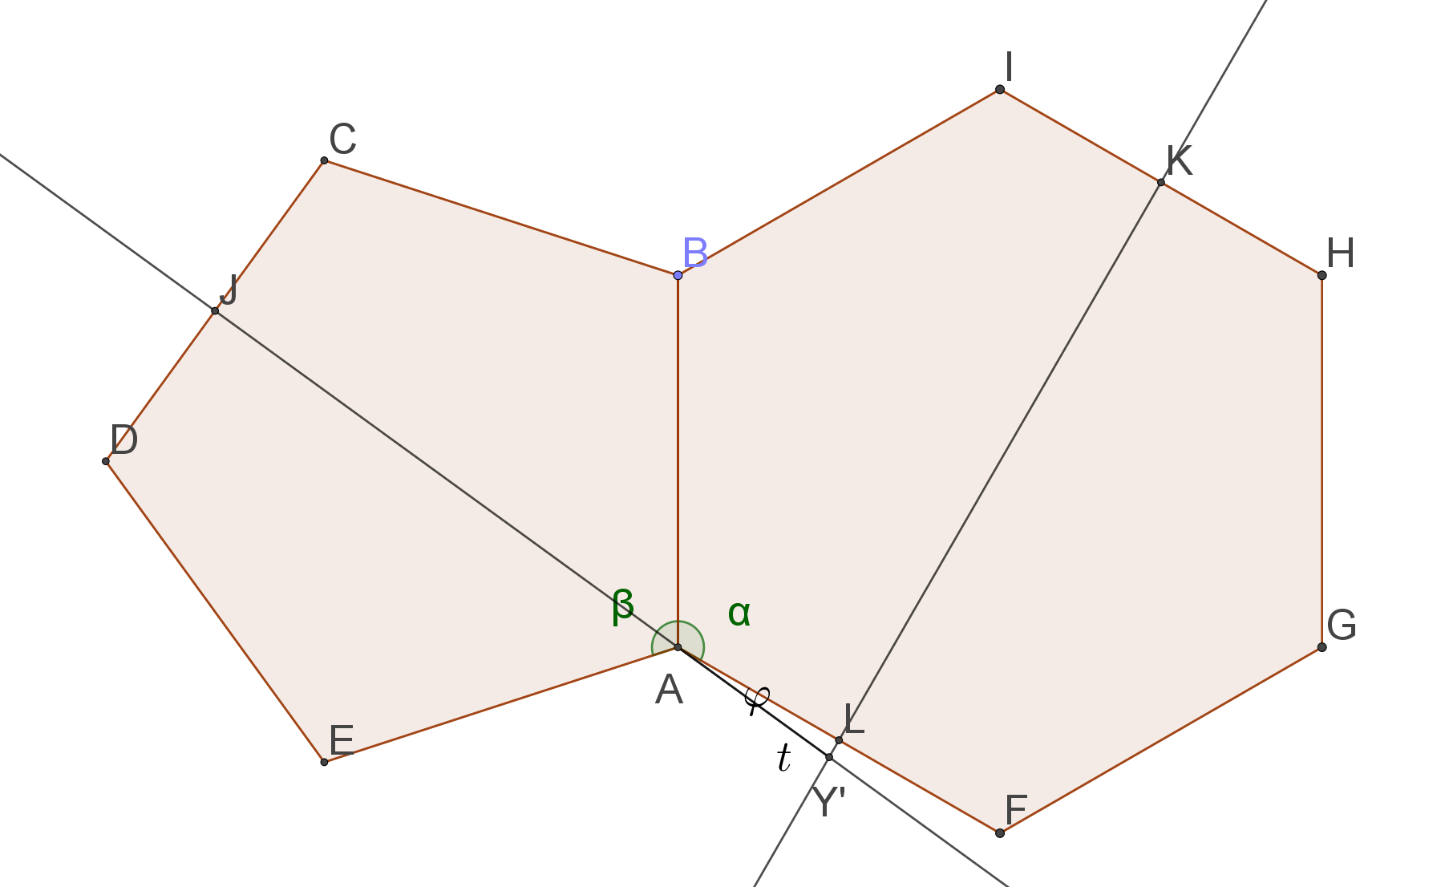
Complementary scutoid 5-6: the lenght of the leg of scutellum
We calculate the angle $φ={180}^{0}− α−\frac{β}{2}=6^{0},$l$enght of t=\frac{a}{2∙\cos{φ}}$ $\left(AY^{′}L\right), and in the triangle$ $AY^{′}Y$ use the Pythagorean theorem: $AY=x, AY^{′}=t, Y^{′}Y=\frac{h}{2}$

Slide 15
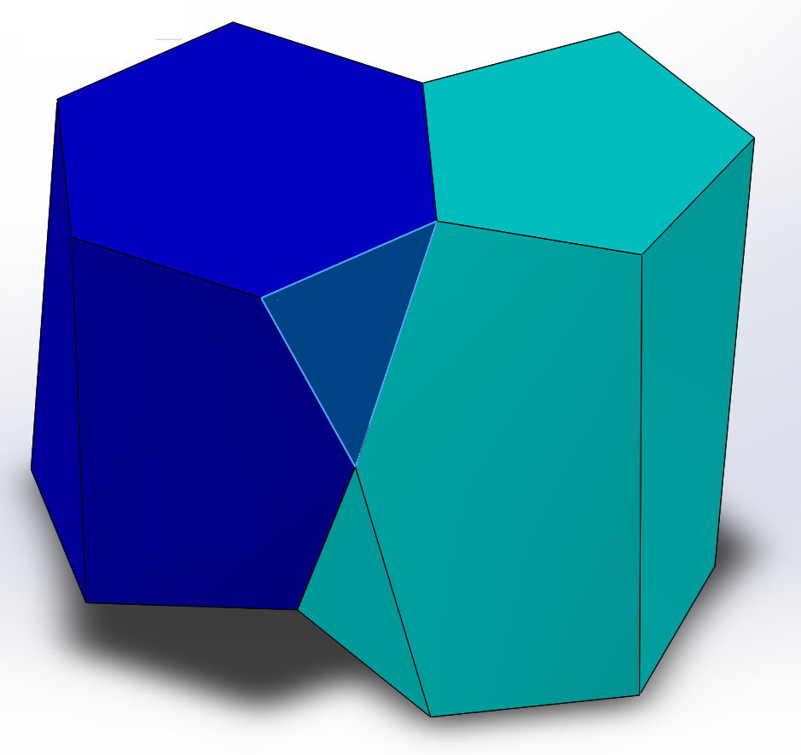
Complementary scutoid 5-6: the lenght of the leg of scutellum
$$x^{2}={\left(\frac{h}{2}\right)}^{2}+t^{2}$$
$$the leg of scutellum= x=$$
$$=\frac{\sqrt{2}∙\sqrt{h^{2}∙(1+cos{{12}^{0})+2a^{2}}}}{4∙\cos{6^{0}}}$$

Slide 16
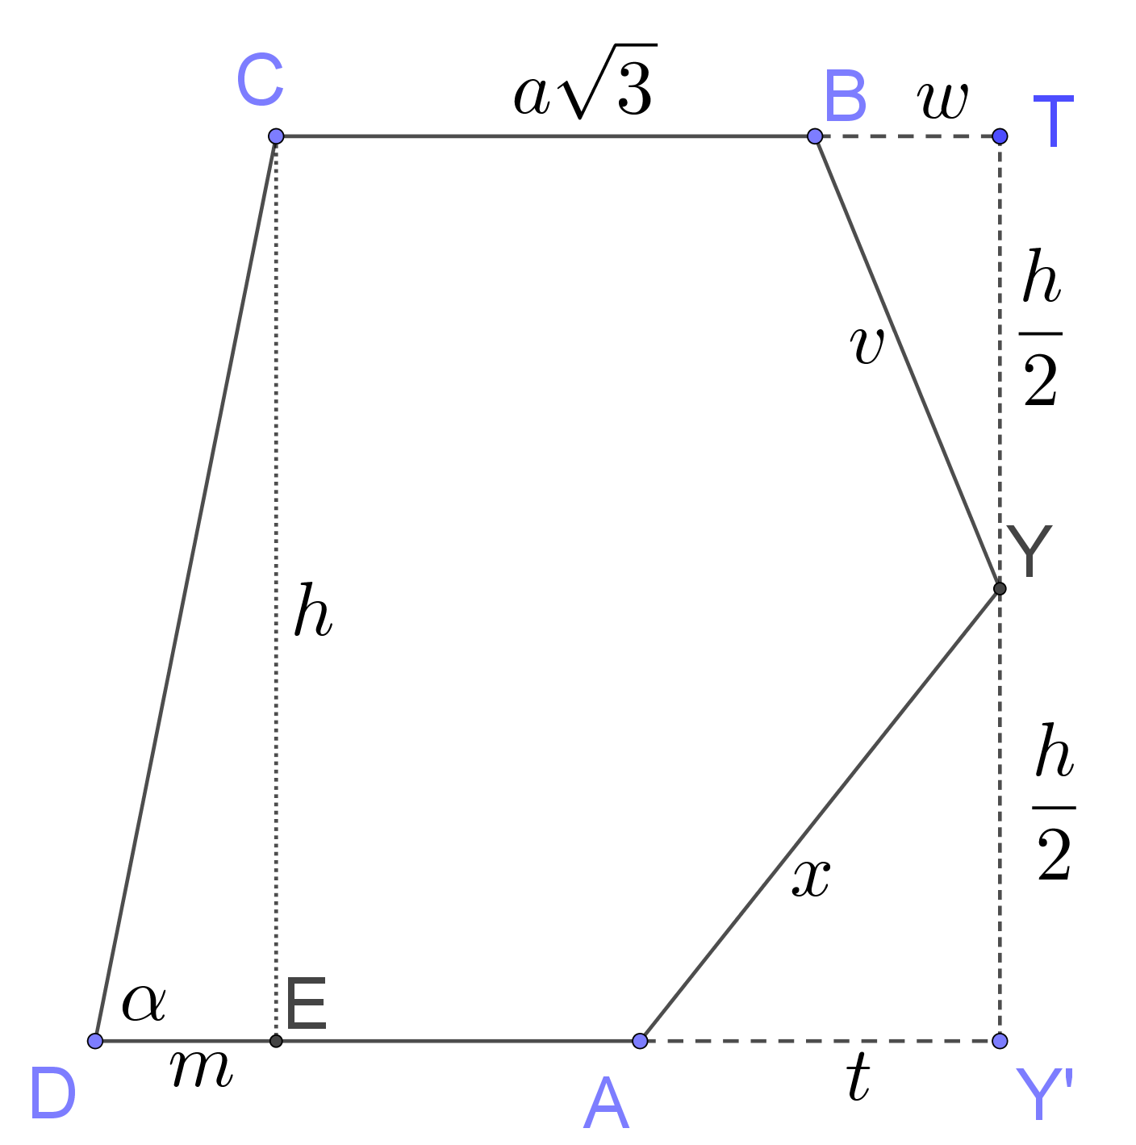
Complementary scutoid 5-6: the angle of inclination of the back surface
$$\tan{α}=\frac{2h(\sin\left.6^{0}+1\right)}{a(\cos{6^{0}}+(\sqrt{2\sqrt{5}+5}−2\sqrt{3})(\sin\left.6^{0}+1)\right)}$$
The model of complementary scutoid 5-6 the lenght of side $a=3.5 cm$ and height $h=8.8 cm$. In this case the angle of inclination equals $α {= 84.16388769}^{0}.$

Slide 17
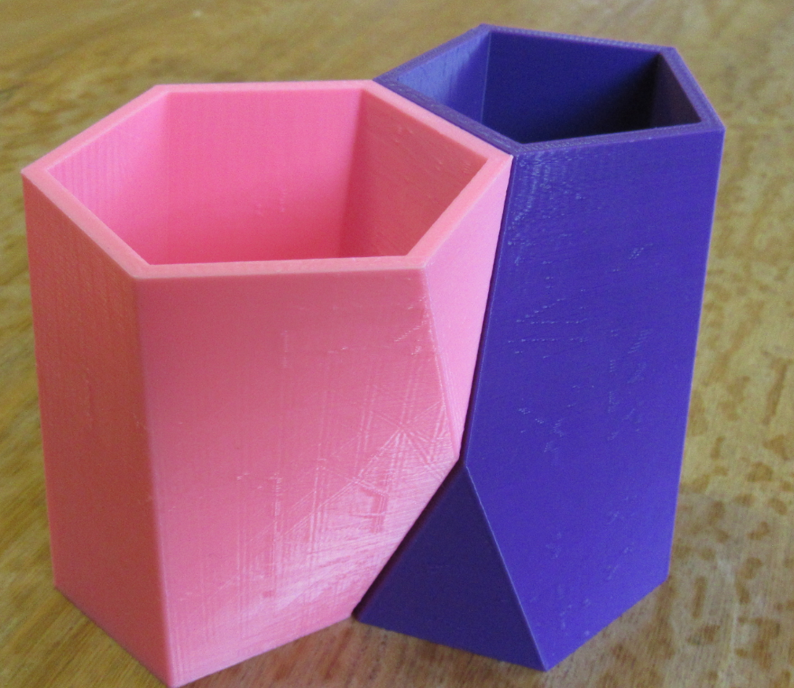
Complementary scutoid 5-6- connecting 3x

Slide 18
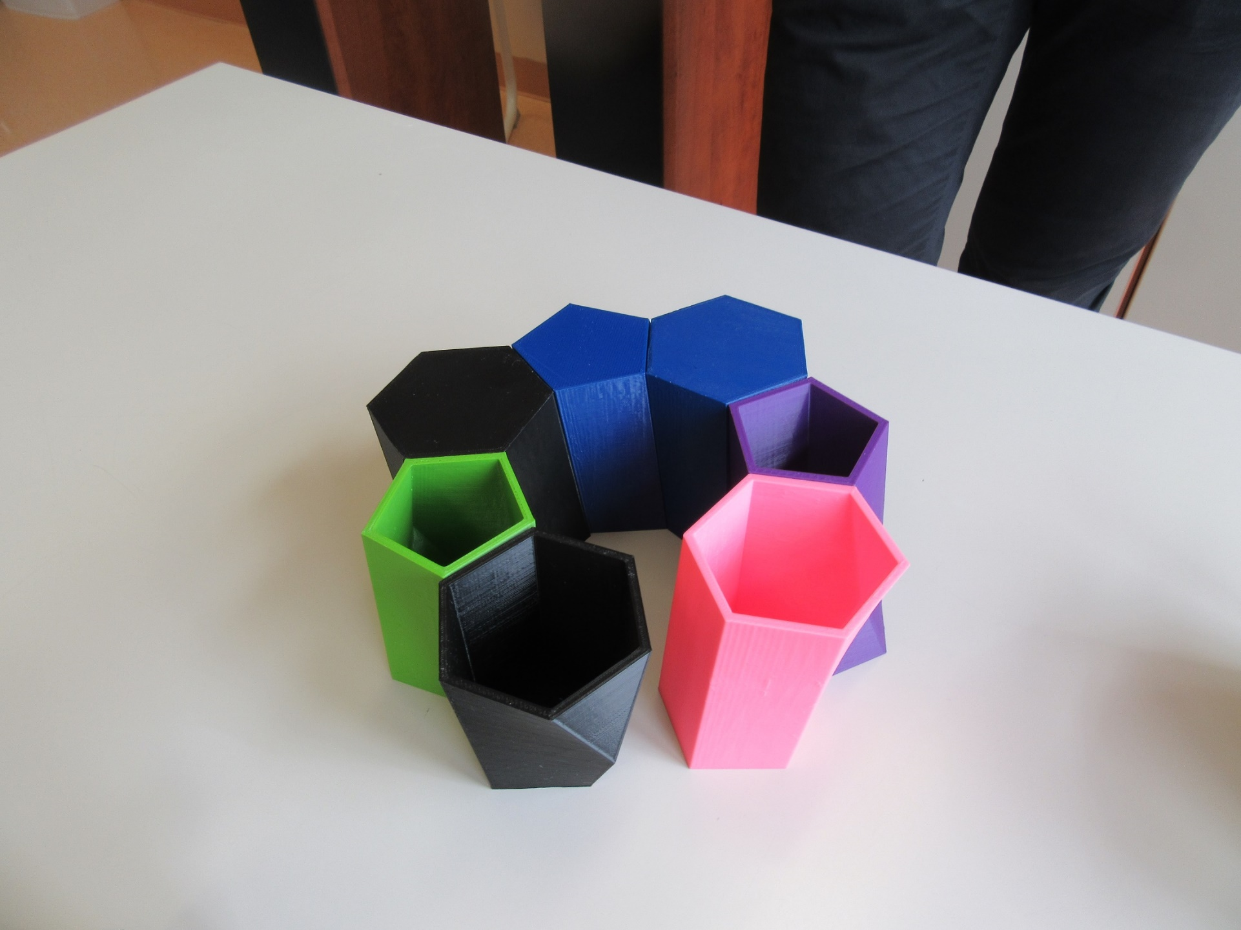
We can‘t construct the circle, because the equation $k∙48=360$ is not solvable in $N$.

Slide 19
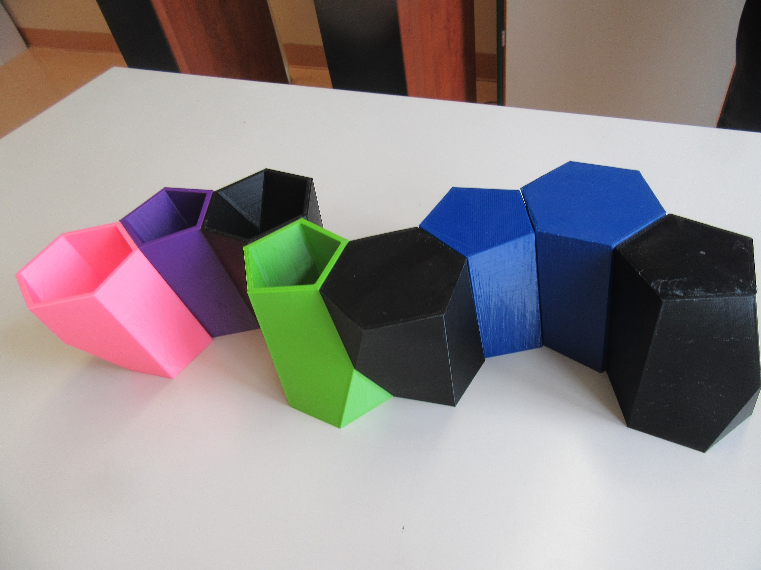

Slide 20
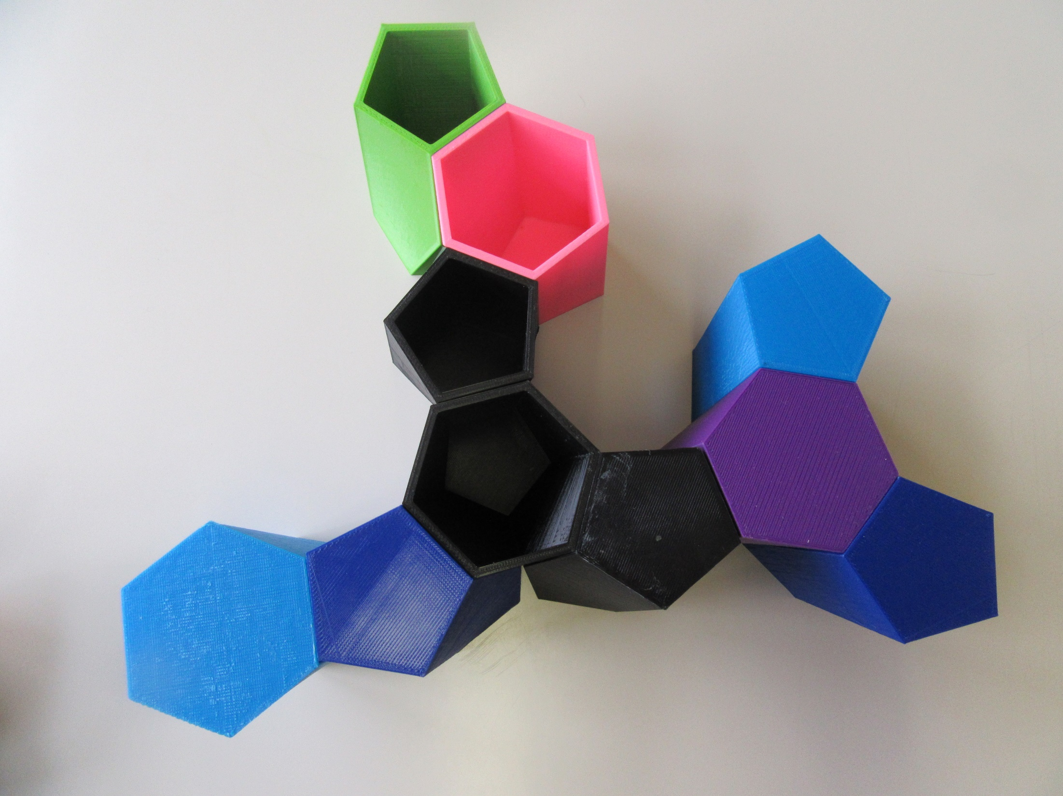

Slide 21
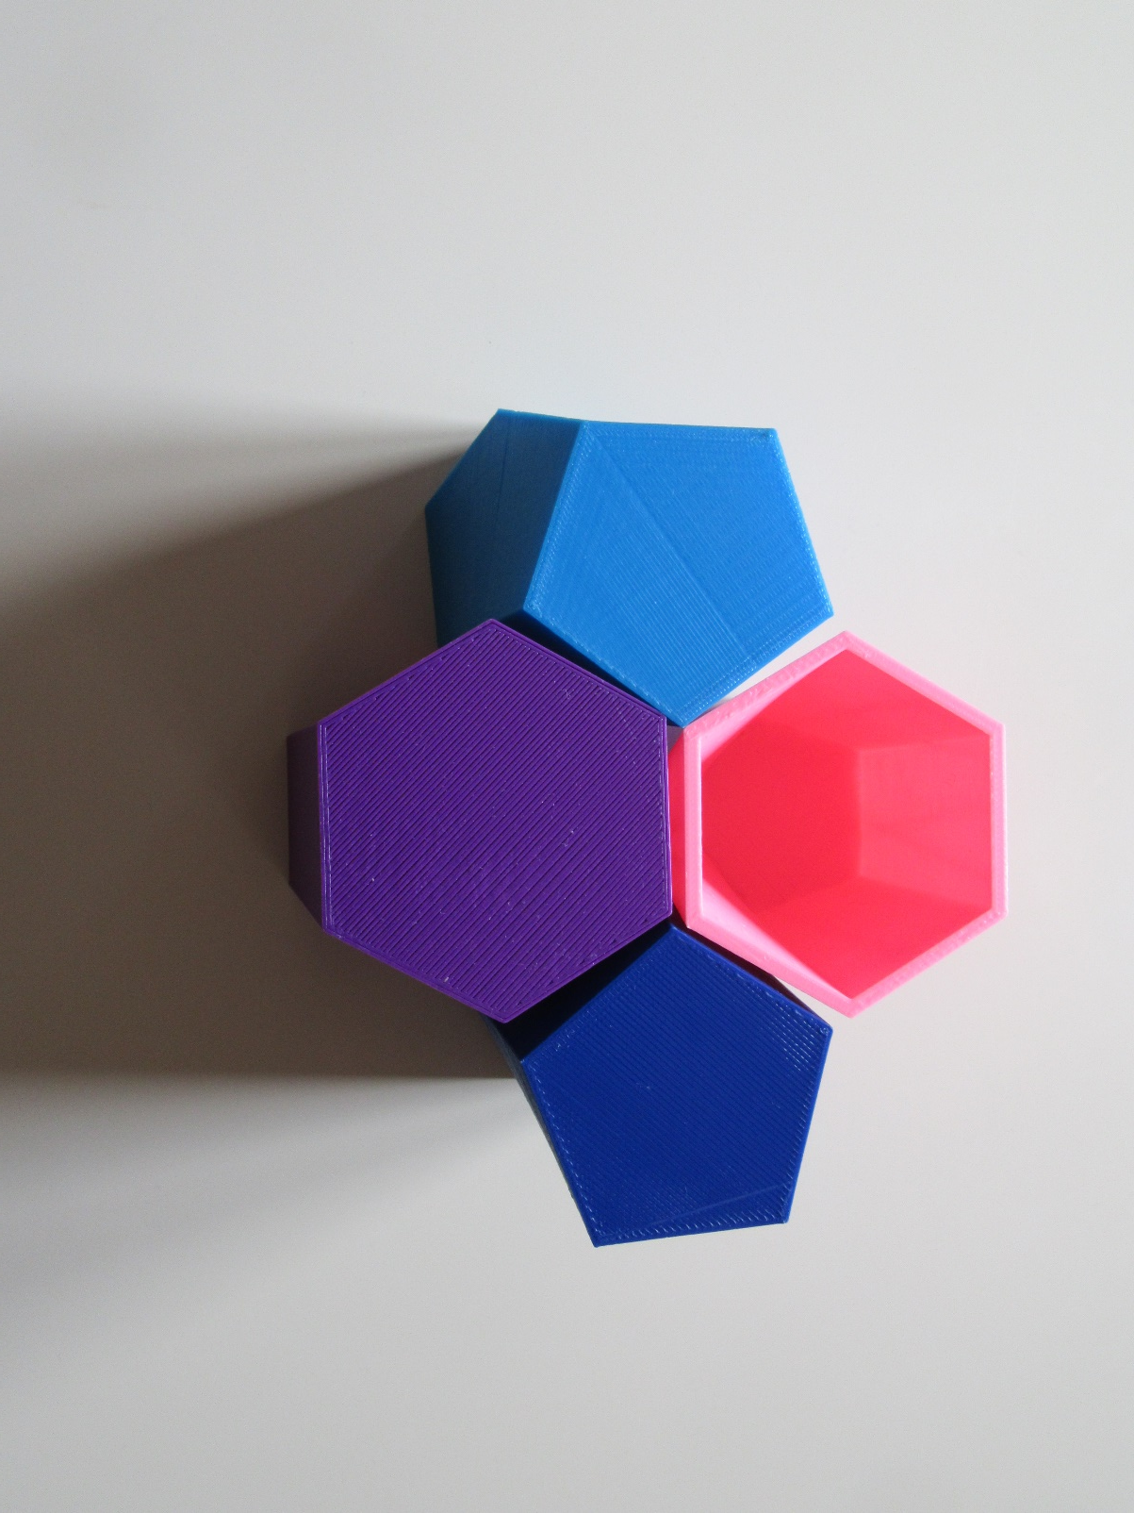
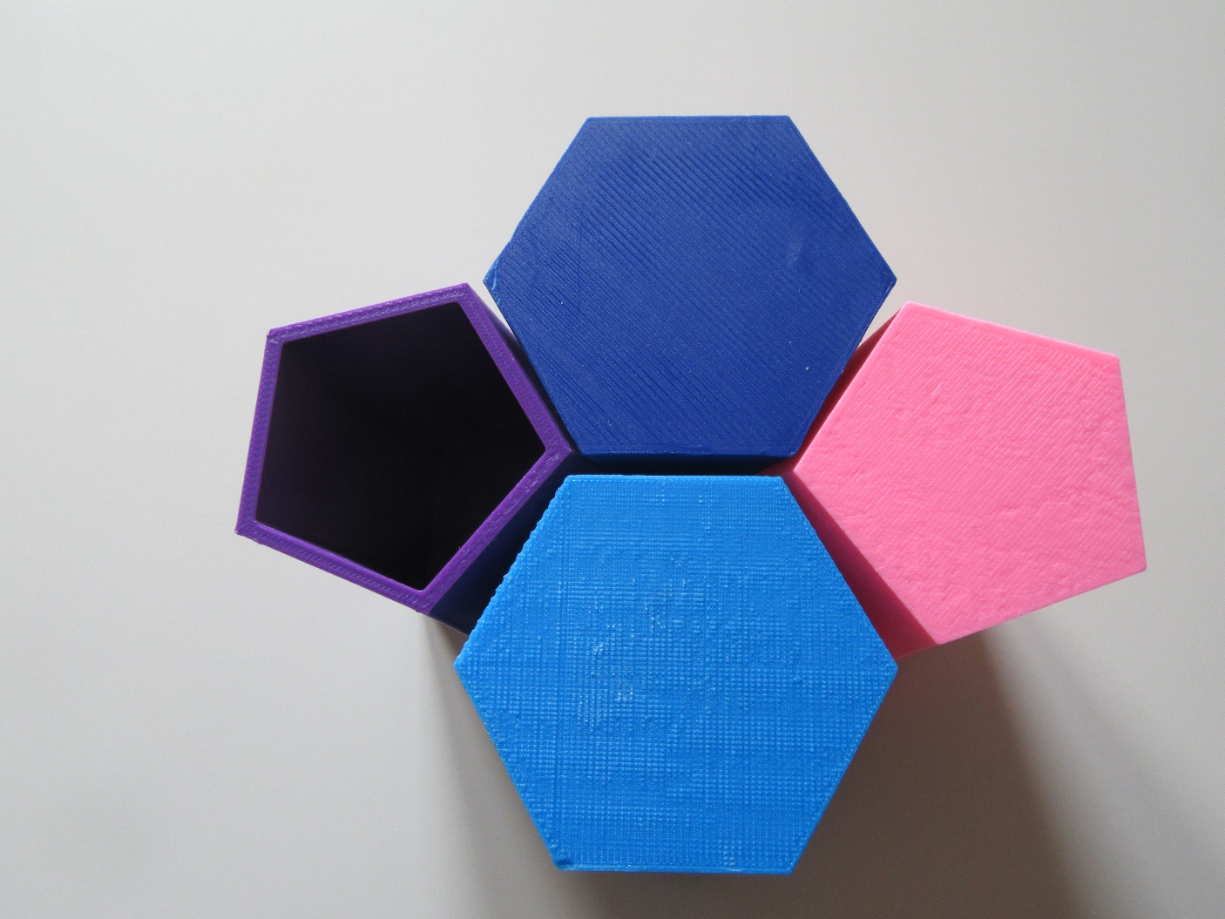
The view from above (left) and from bellow (right)
→ Different neighbours

Slide 22
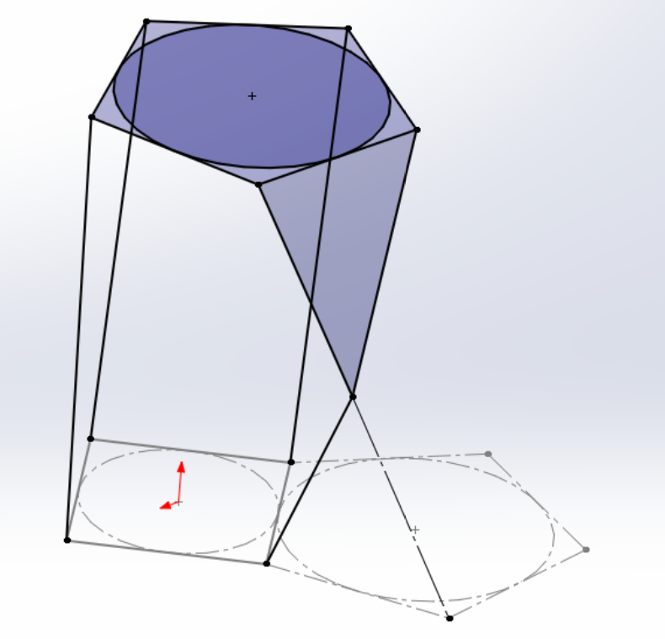
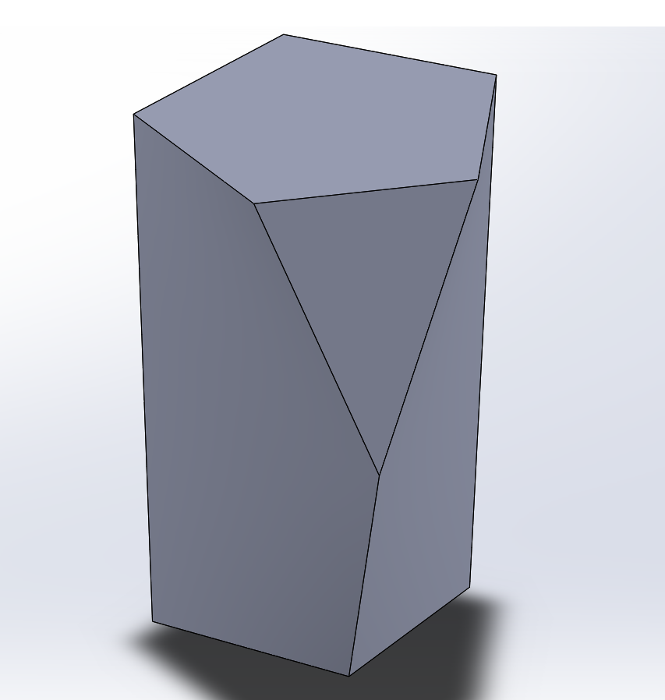
Complementary scutoid 4-5 – construction SOLIDWORKS

Slide 23
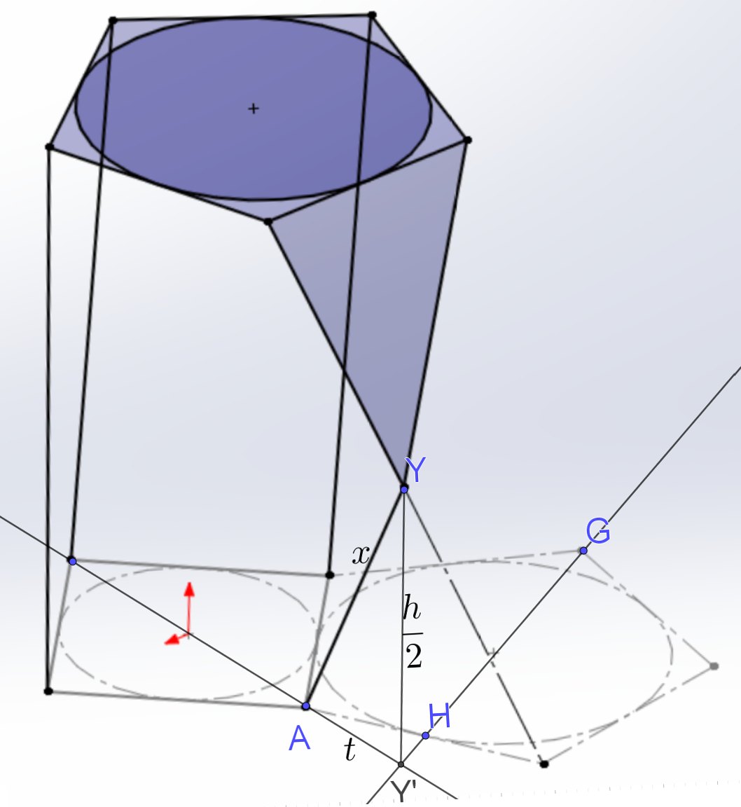
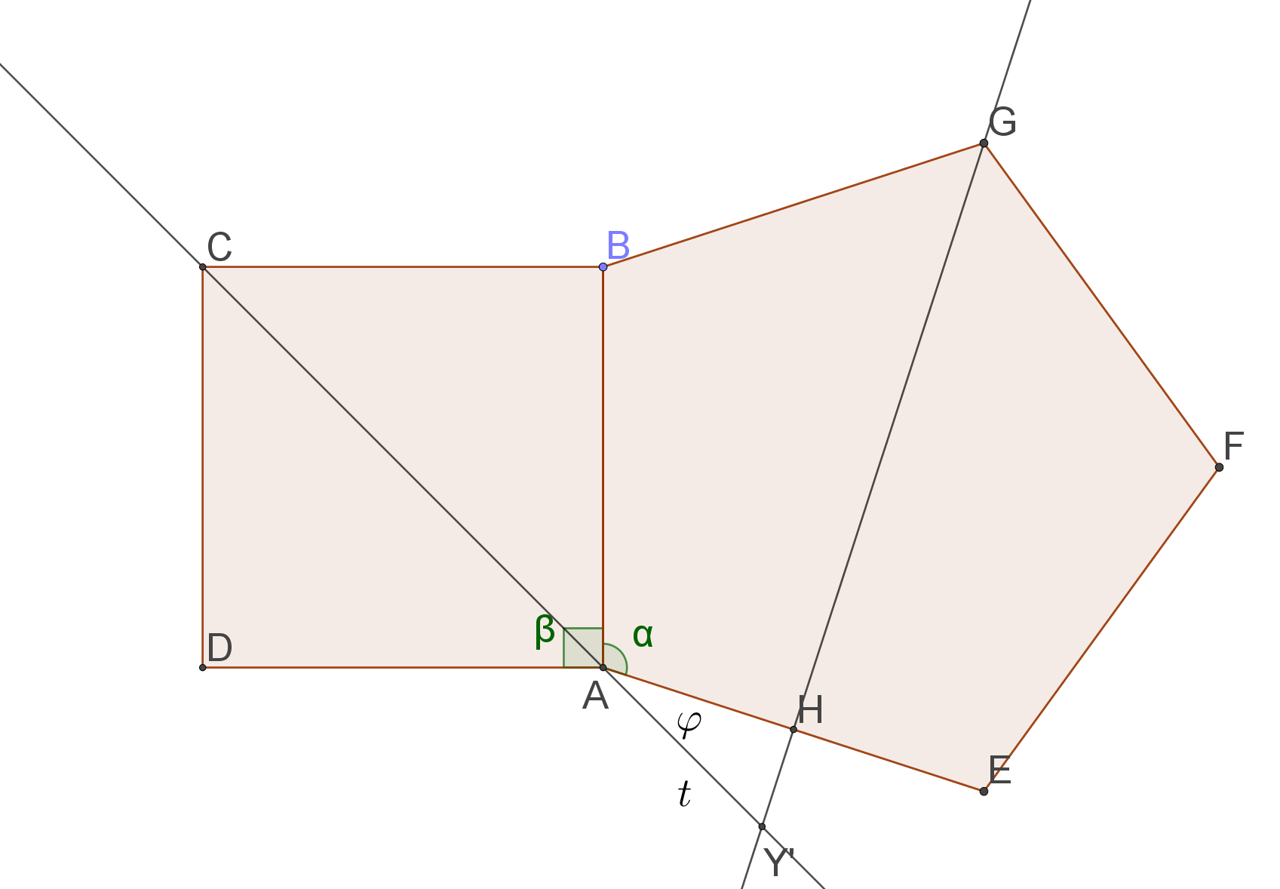
Complementary scutoid 4-5: the lenght of the leg of scutellum
$$φ={180}^{0}− α−\frac{β}{2}={27}^{0}$$
$$the leg of scutellum=x=\frac{\sqrt{h^{2}− 2a^{2}\left(\sqrt{\left(50 − 22\sqrt{5}\right)} + 2\sqrt{5} − 6\right)}}{2}$$

Slide 24
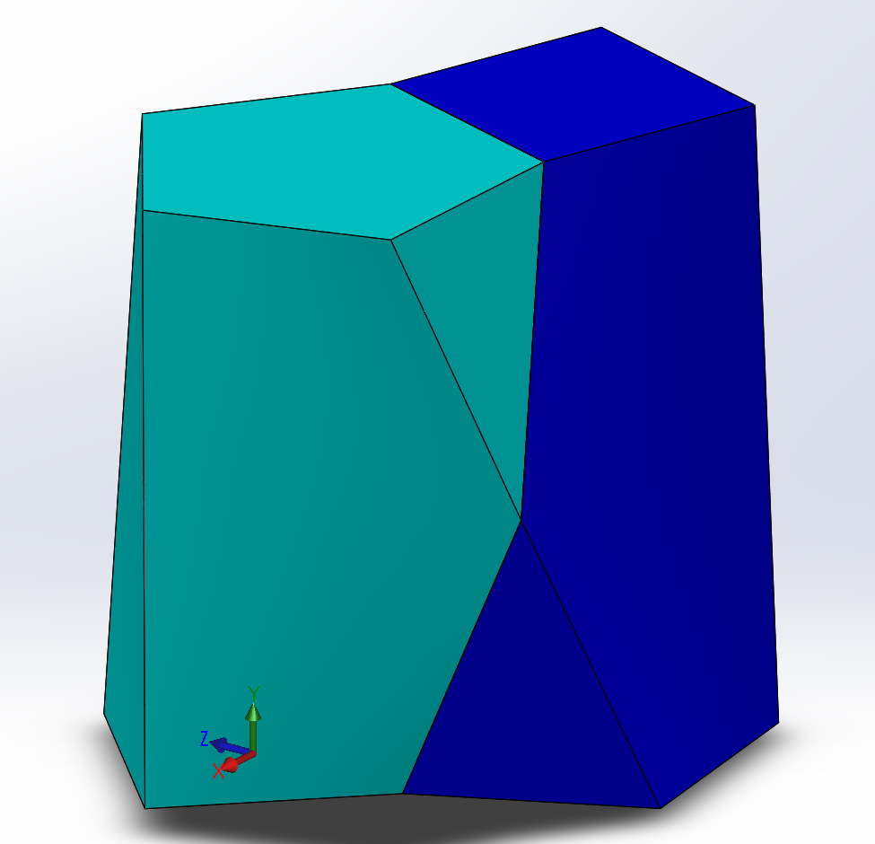
Complementary scutoid 4-5: doesn‘t have the back surface
Doesn‘t have the back surface, opposite Y is the side edge

Slide 25
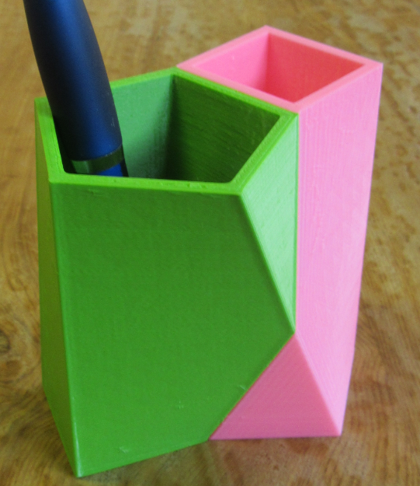
Complementary scutoid 4-5: connecting 2x

Slide 26
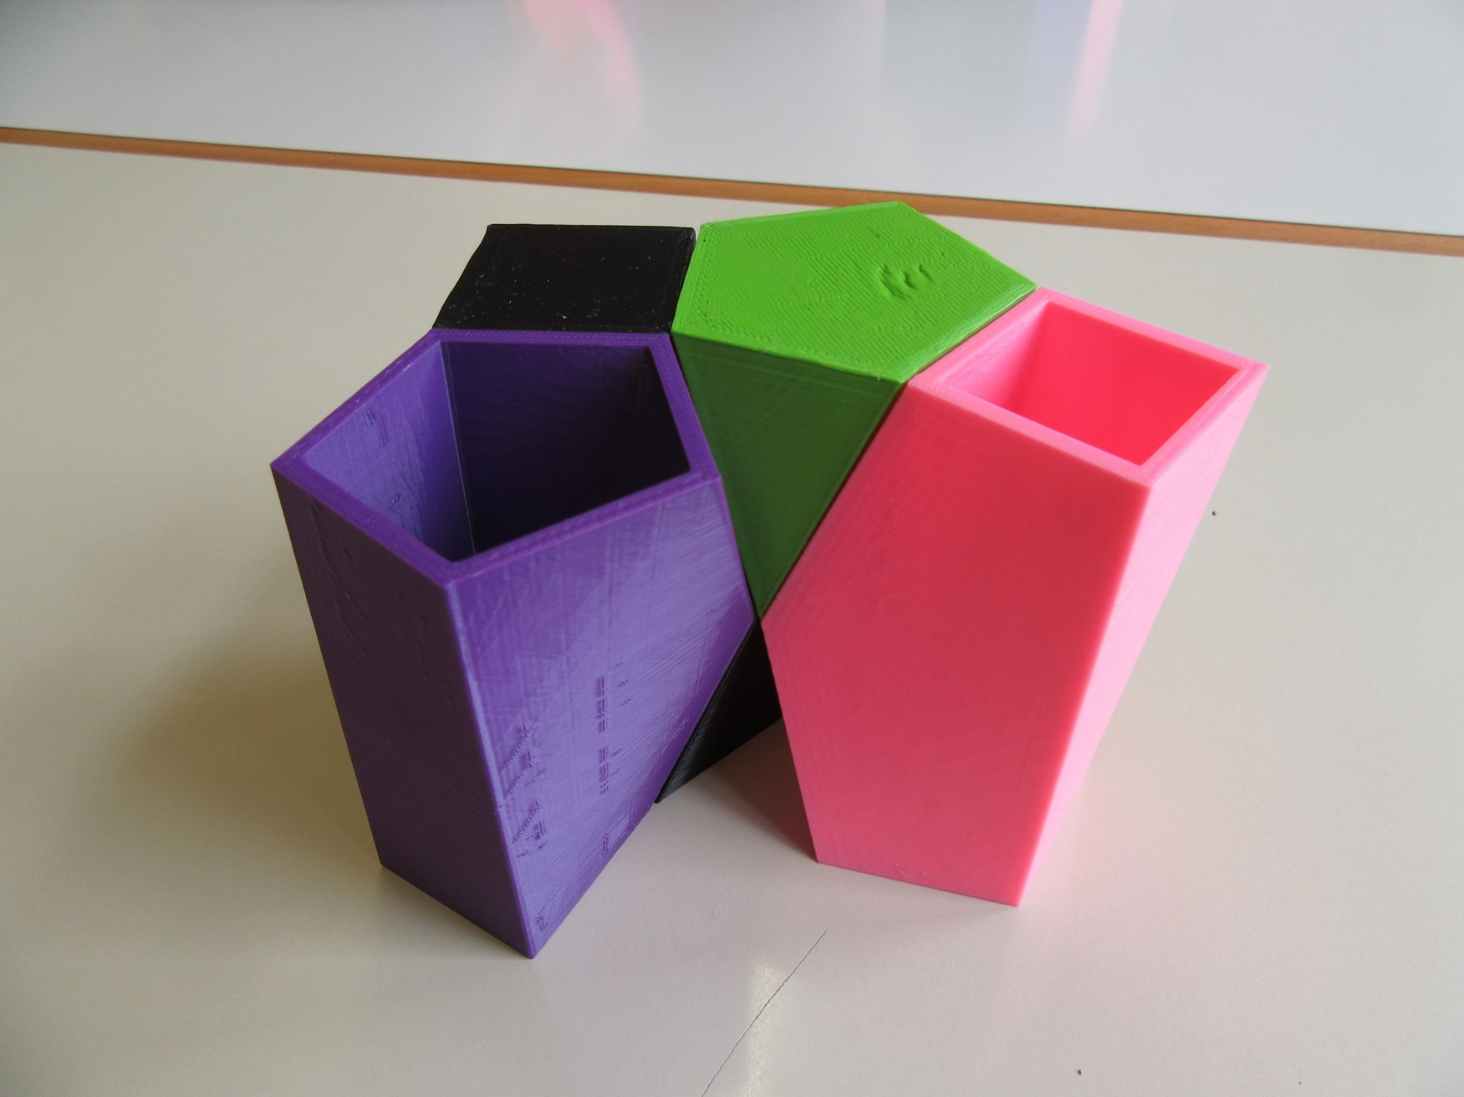
One after another we can compose only four complementary scutoids 4-5

Slide 27
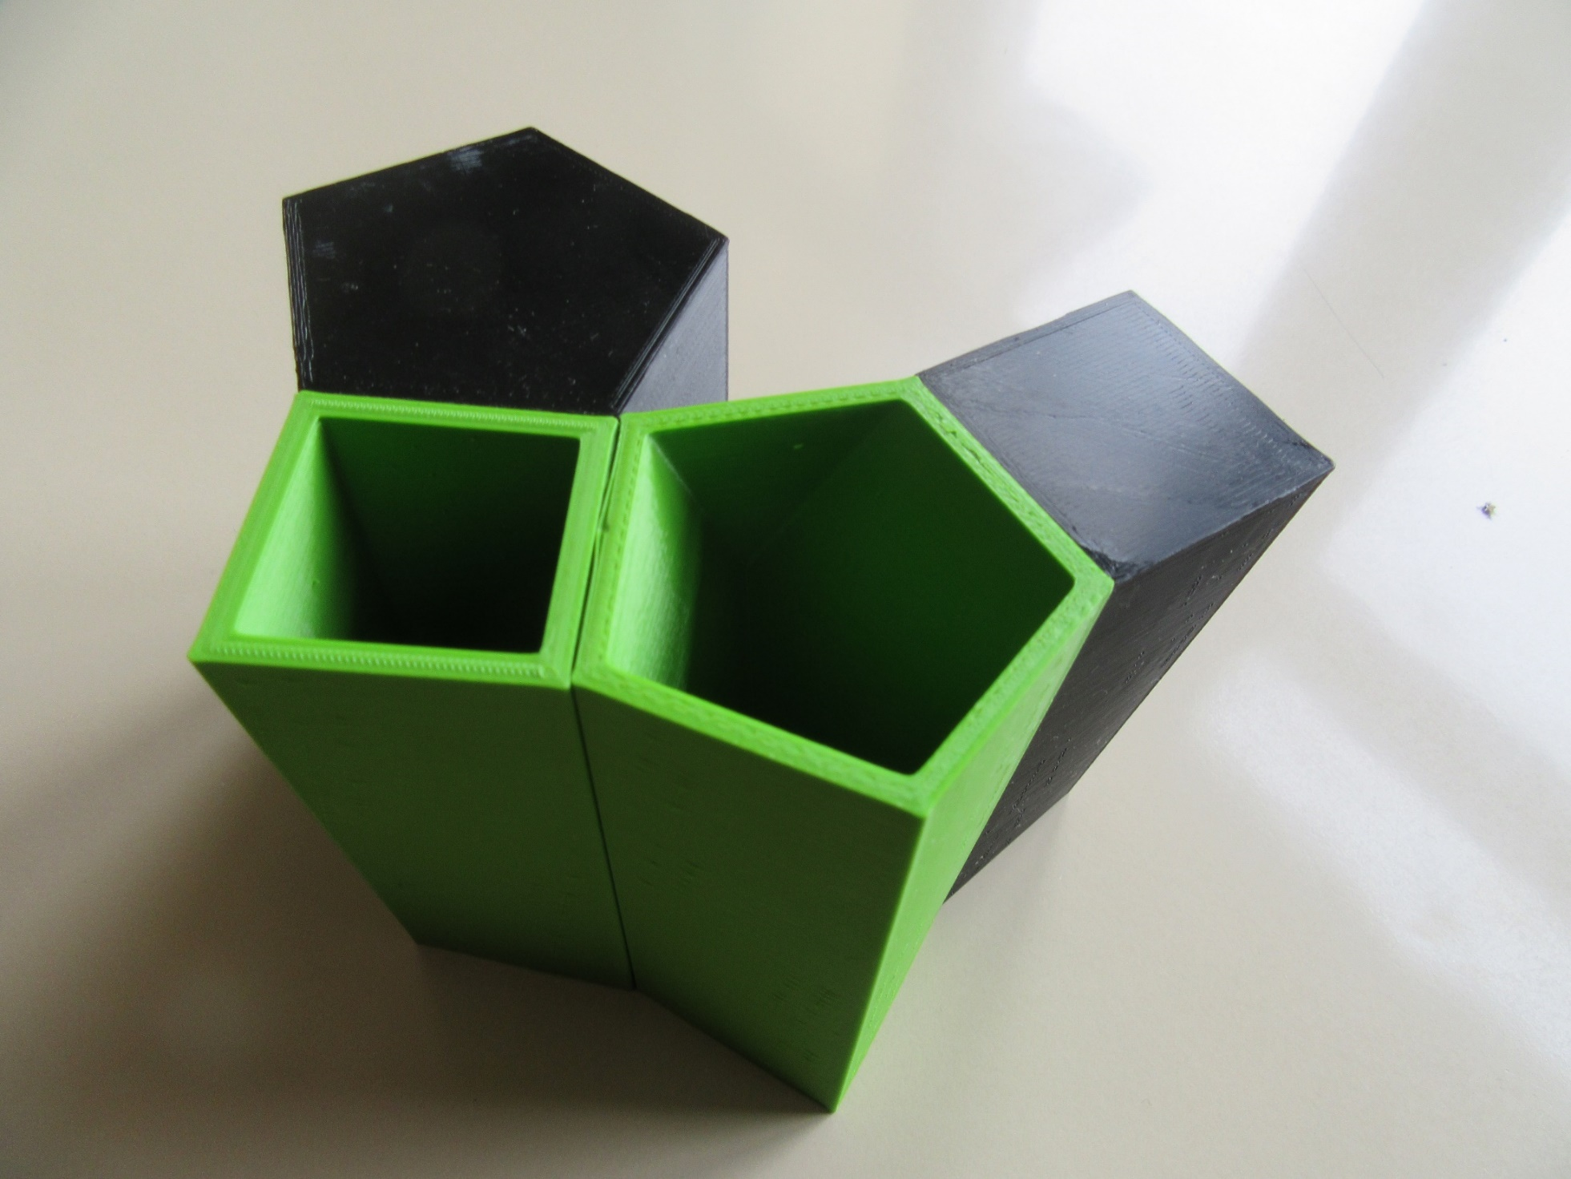
We can not form the circle. The equation $k∙18=360$ is in N solvable, but we can not compose more than four scutoids.

Slide 28
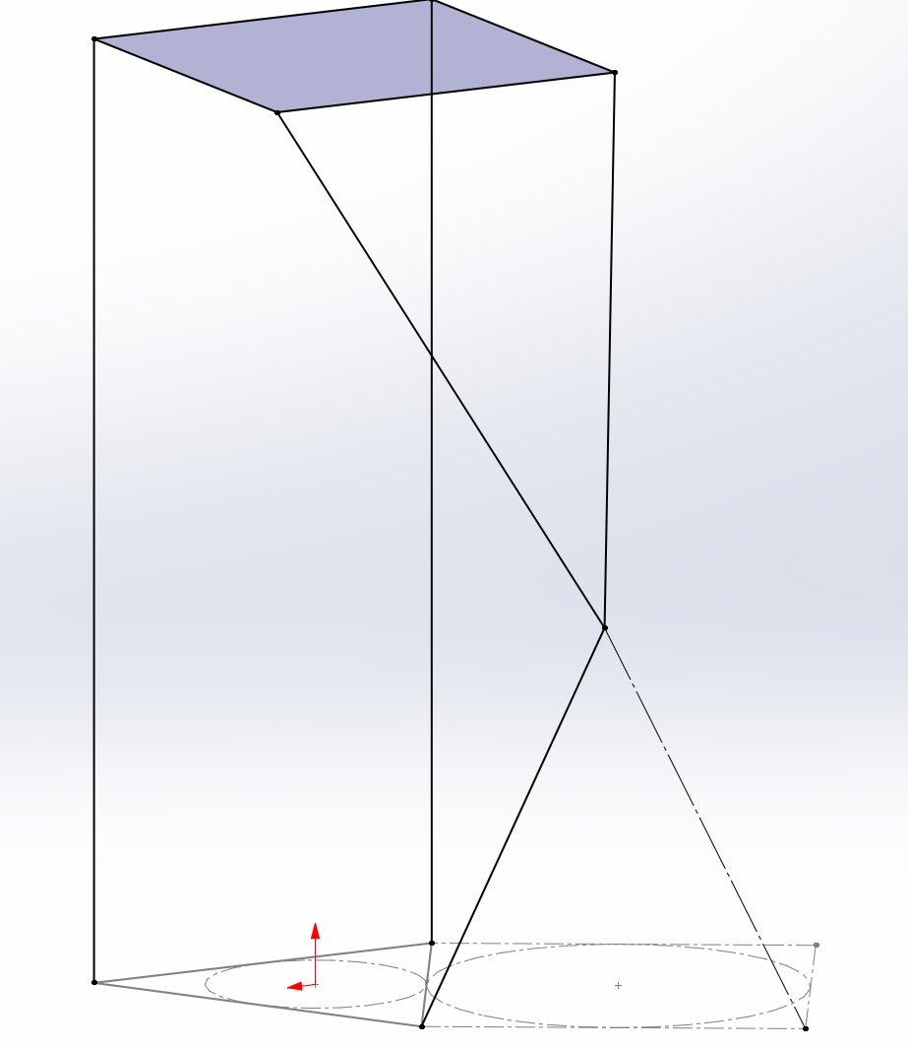
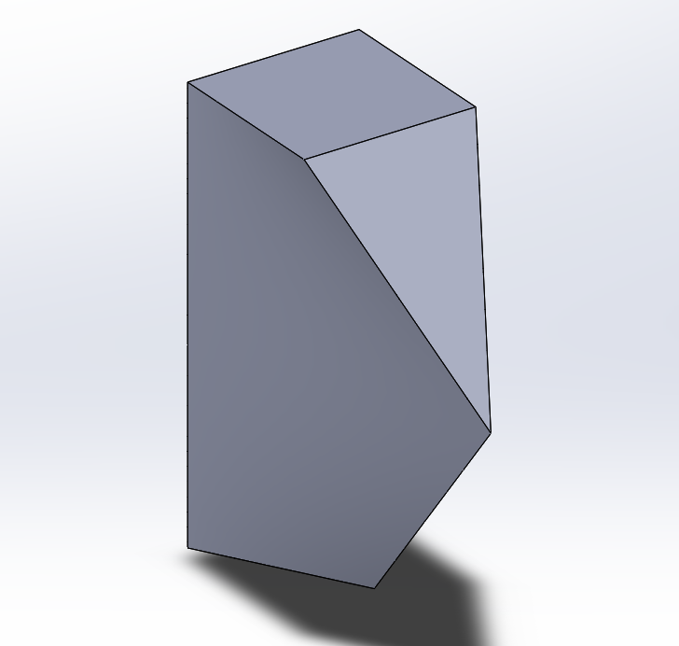
Complementary scutoid 3-4

Slide 29
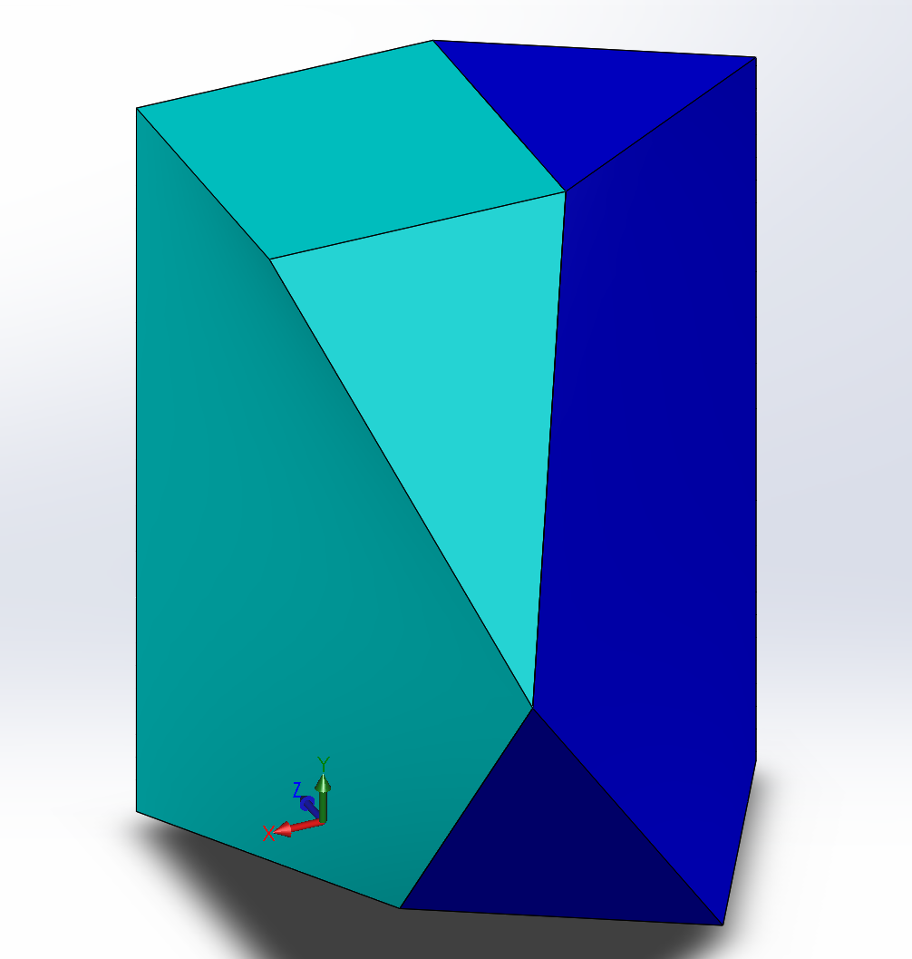
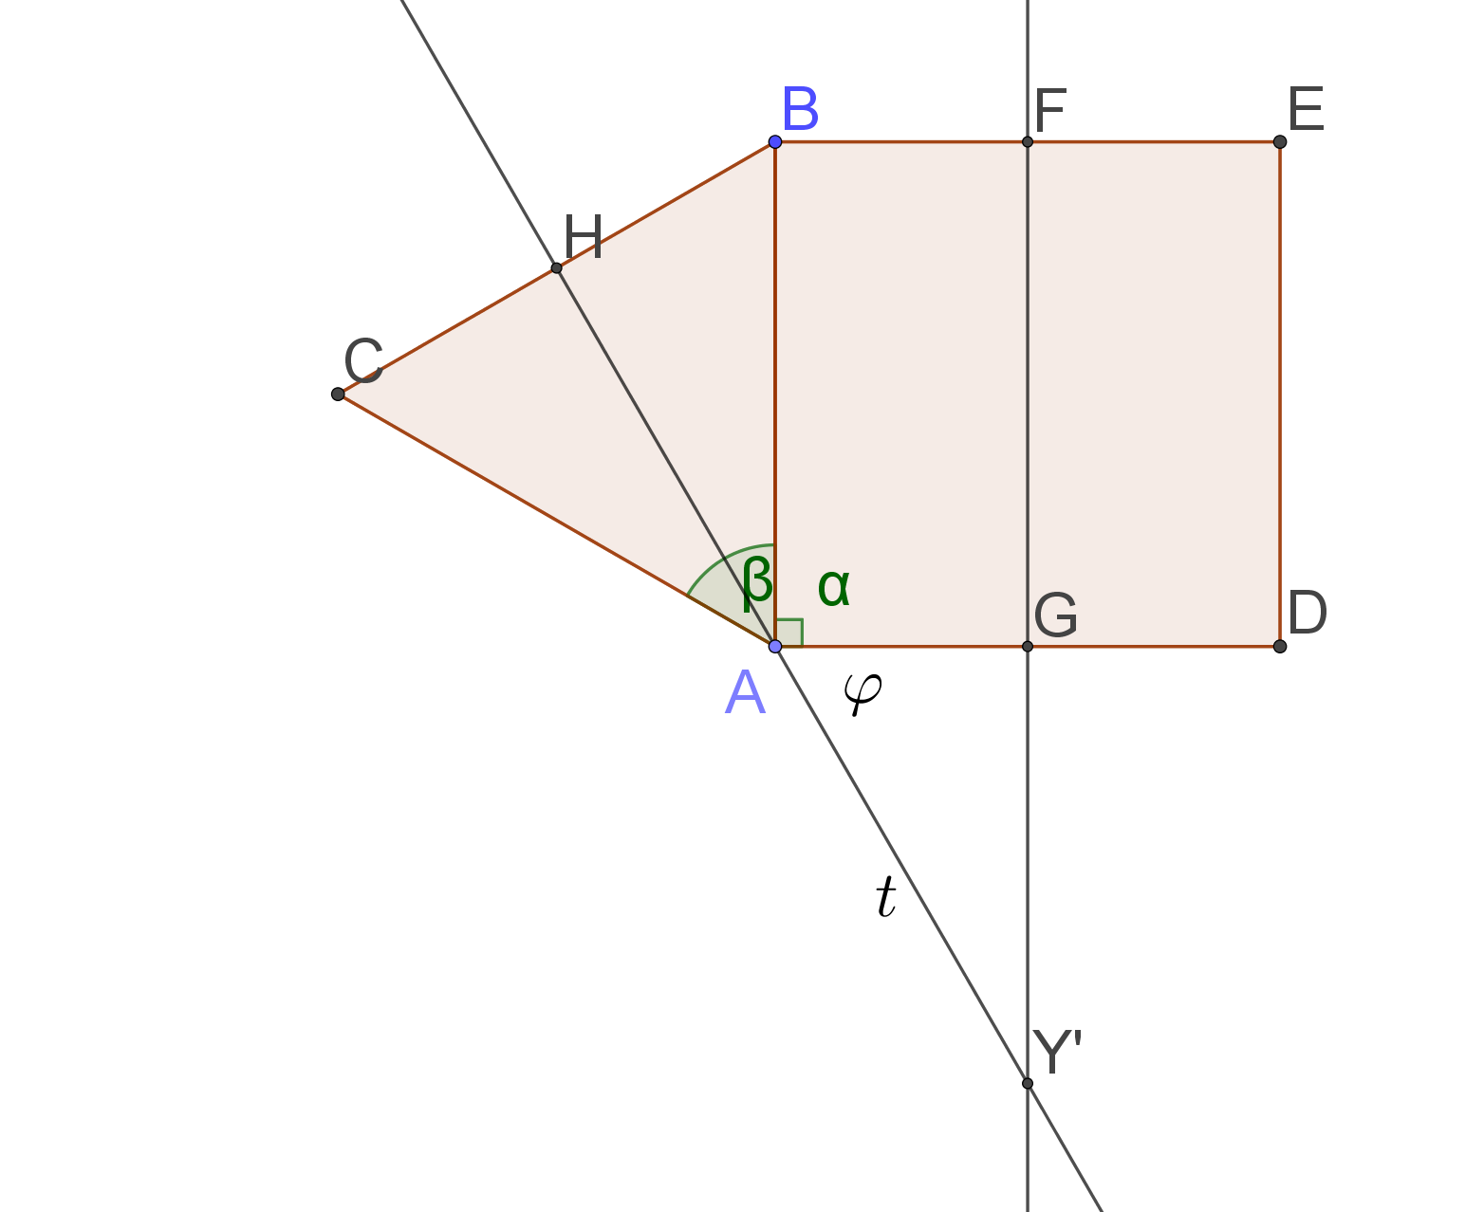
Complementary scutoid 3-4: the lenght of the leg of the scutellum
$$φ={180}^{0}− α−\frac{β}{2}{=60}^{0}$$
The leg of scutellum =
$=\frac{1}{2}\sqrt{\left(4a^{2}+h^{2}\right)}$

Slide 30
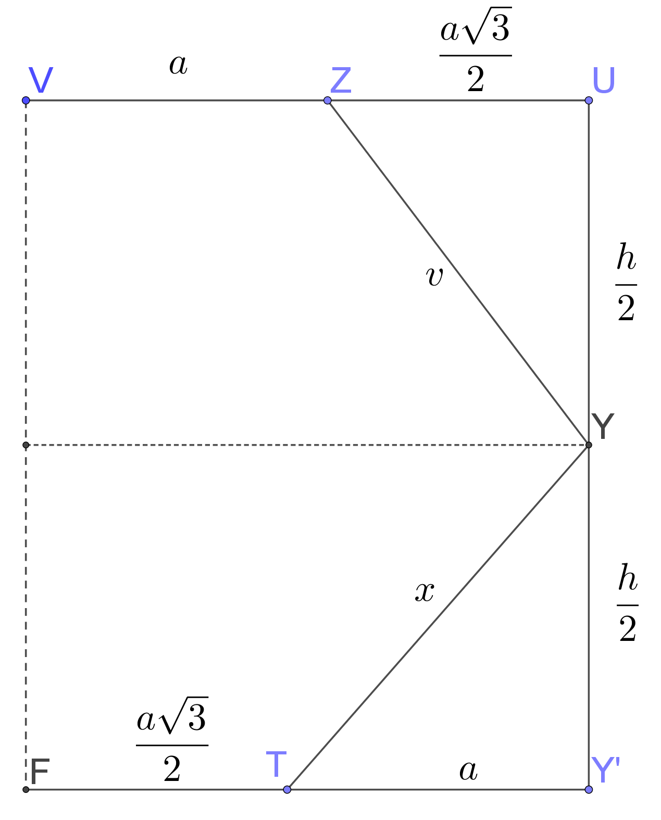
Complementary scutoid 3-4: the angle of inclination of the back surface
The back surface is perpendicular to the plane of the back surface

Slide 31
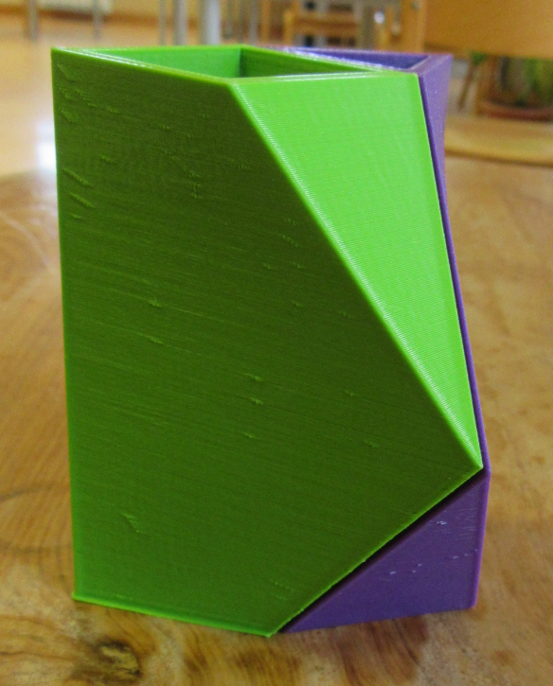
Complementary scutoid 3-4: connecting 4x

Slide 32
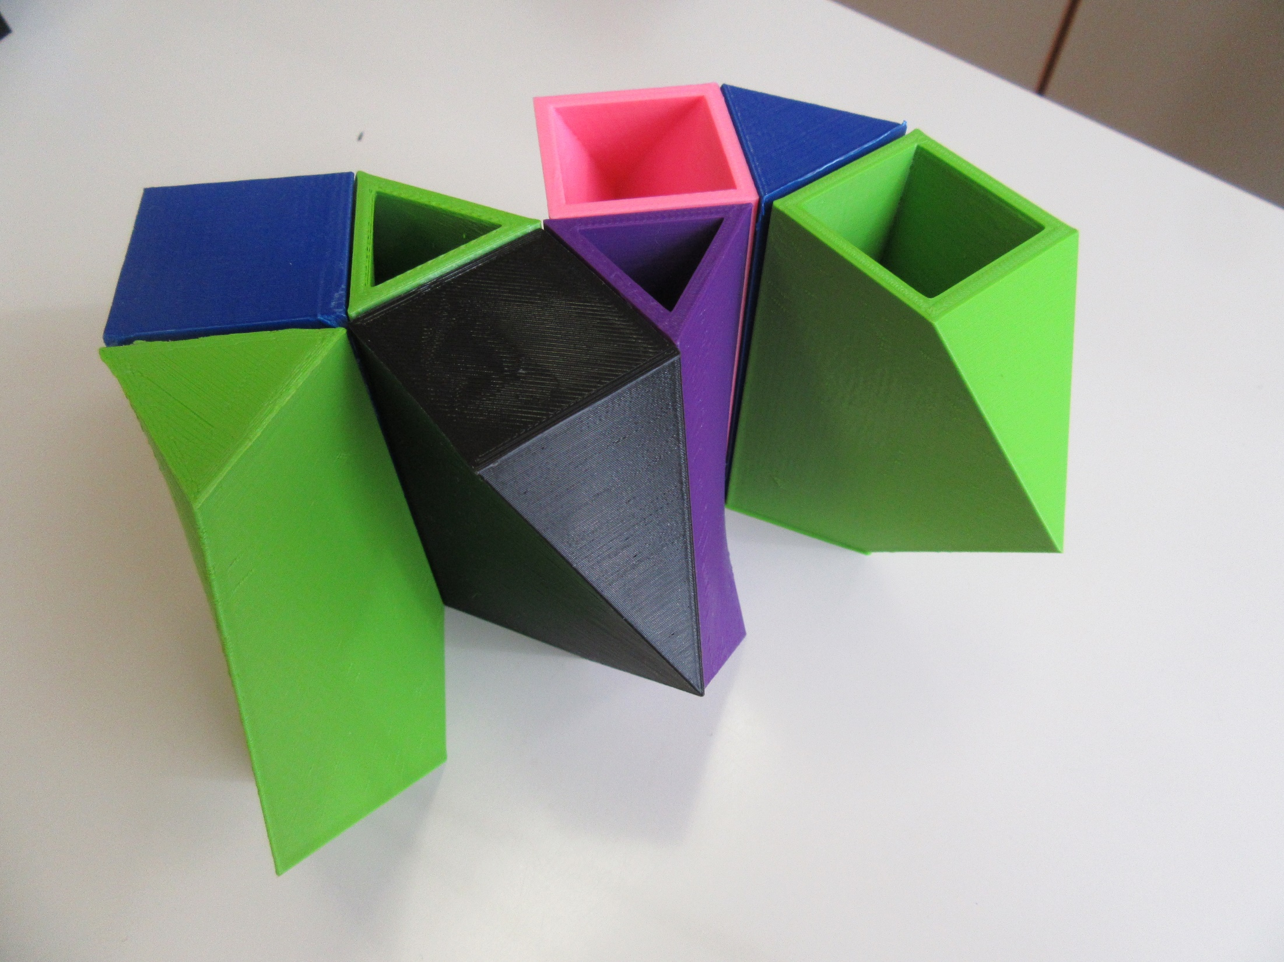

Slide 33
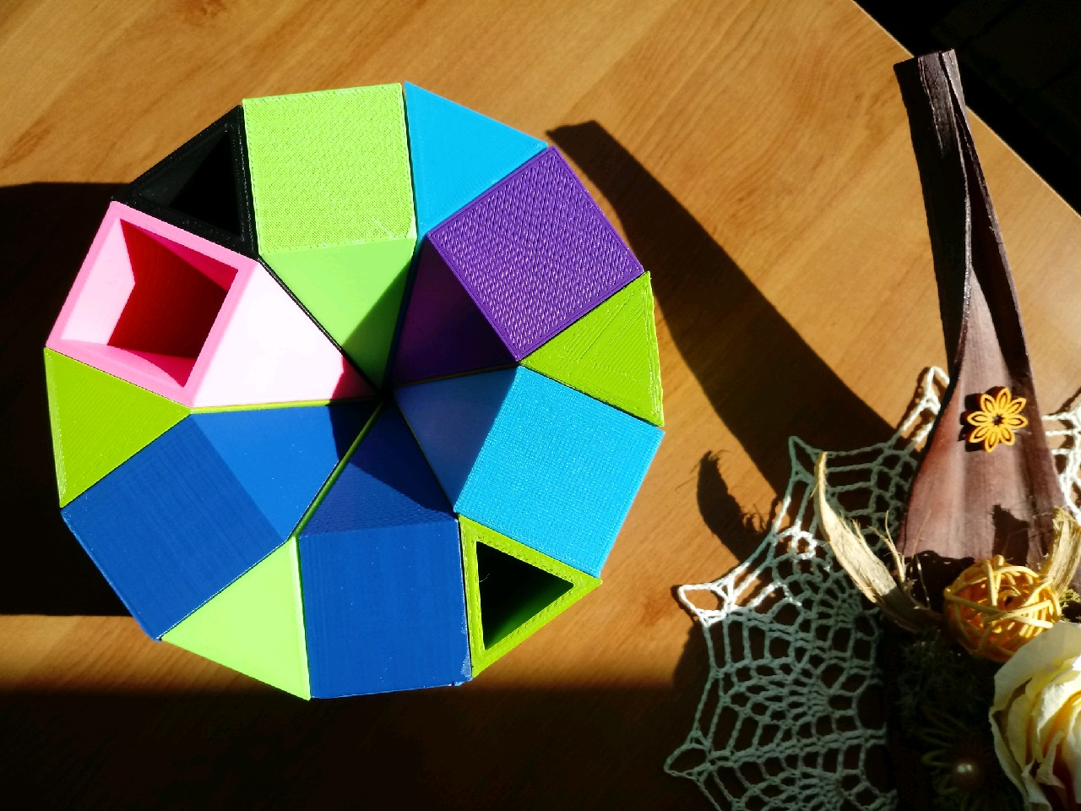
We can form the circle, because the equation $k∙30=360$ is solvable in $N$: we get the regular twelve-angle

Slide 34
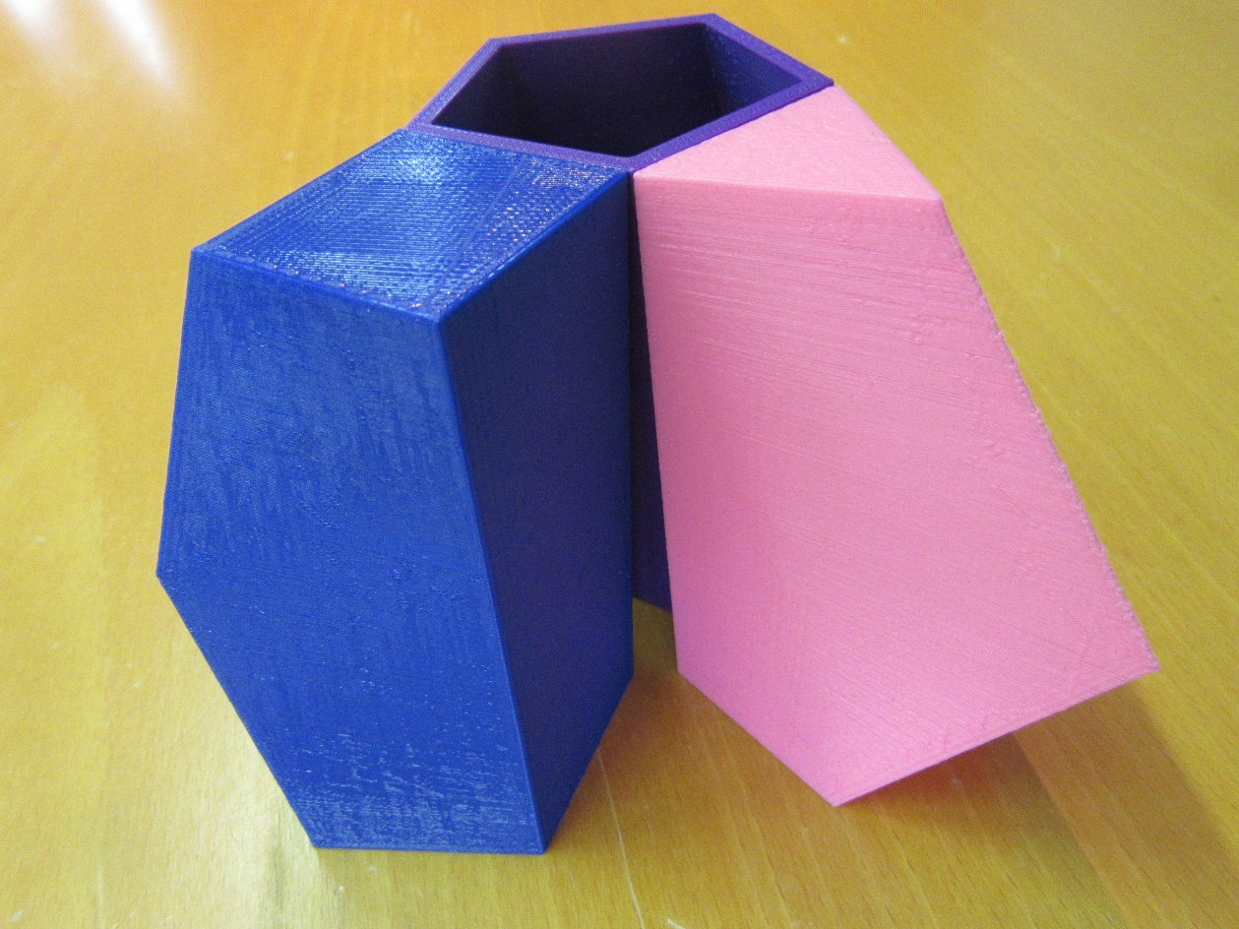
Because of the different agles of inclination and different lenghts of the legs of scutellum different scutoids do not complement one another in the space between two surfaces.

Slide 35
General formula for angle $φ=<HAY′$
$$t=\frac{a}{2∙\cos{φ}}$$
$$α=\frac{\left(n−2)∙180\right.}{n}$$
$$φ(n)=\frac{\left(n^{2}−7n+4\right)}{\left(1−n\right)n}∙{90}^{0}$$
$$β=\frac{\left(n−3)∙180\right.}{n−1}$$
$$x^{2}={\left(\frac{h}{2}\right)}^{2}+t^{2}$$
$$φ={180}^{0}− α−\frac{β}{2}$$

Slide 36
Possible scope of usage:
when modeling the cells in the epithelial tissues
in design
in art
as decorative elements
maybe even in arhitecture
as a creative toy

Slide 37
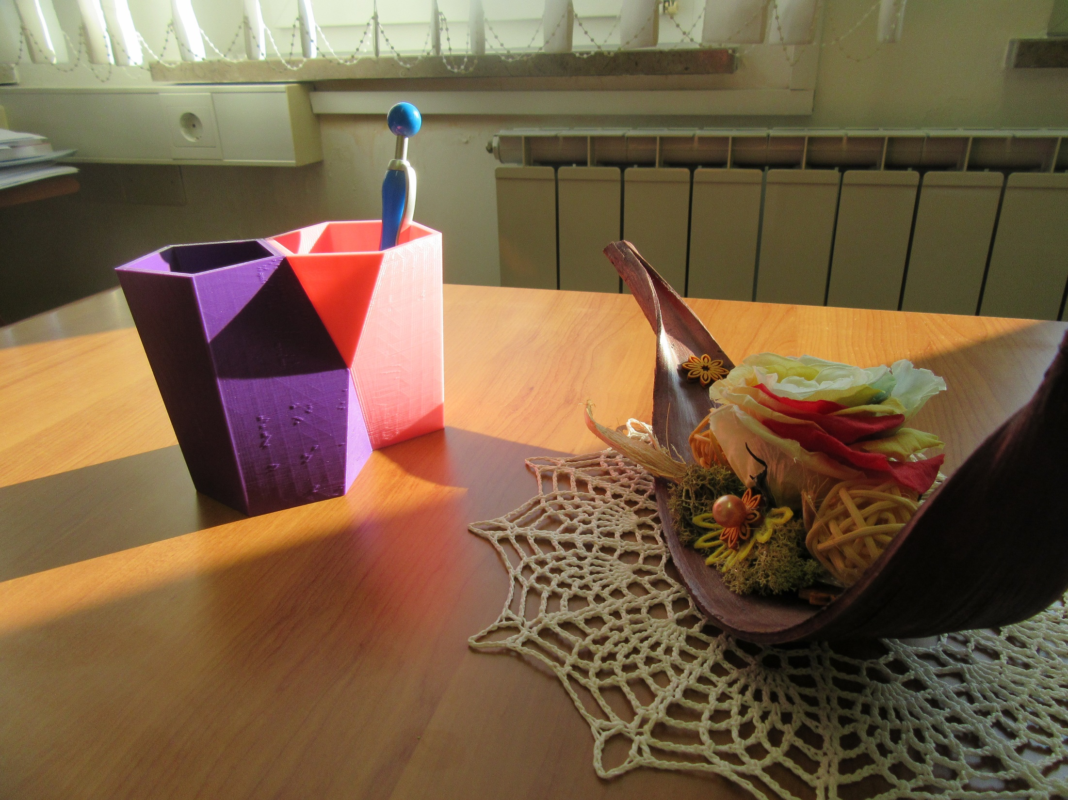

Slide 38
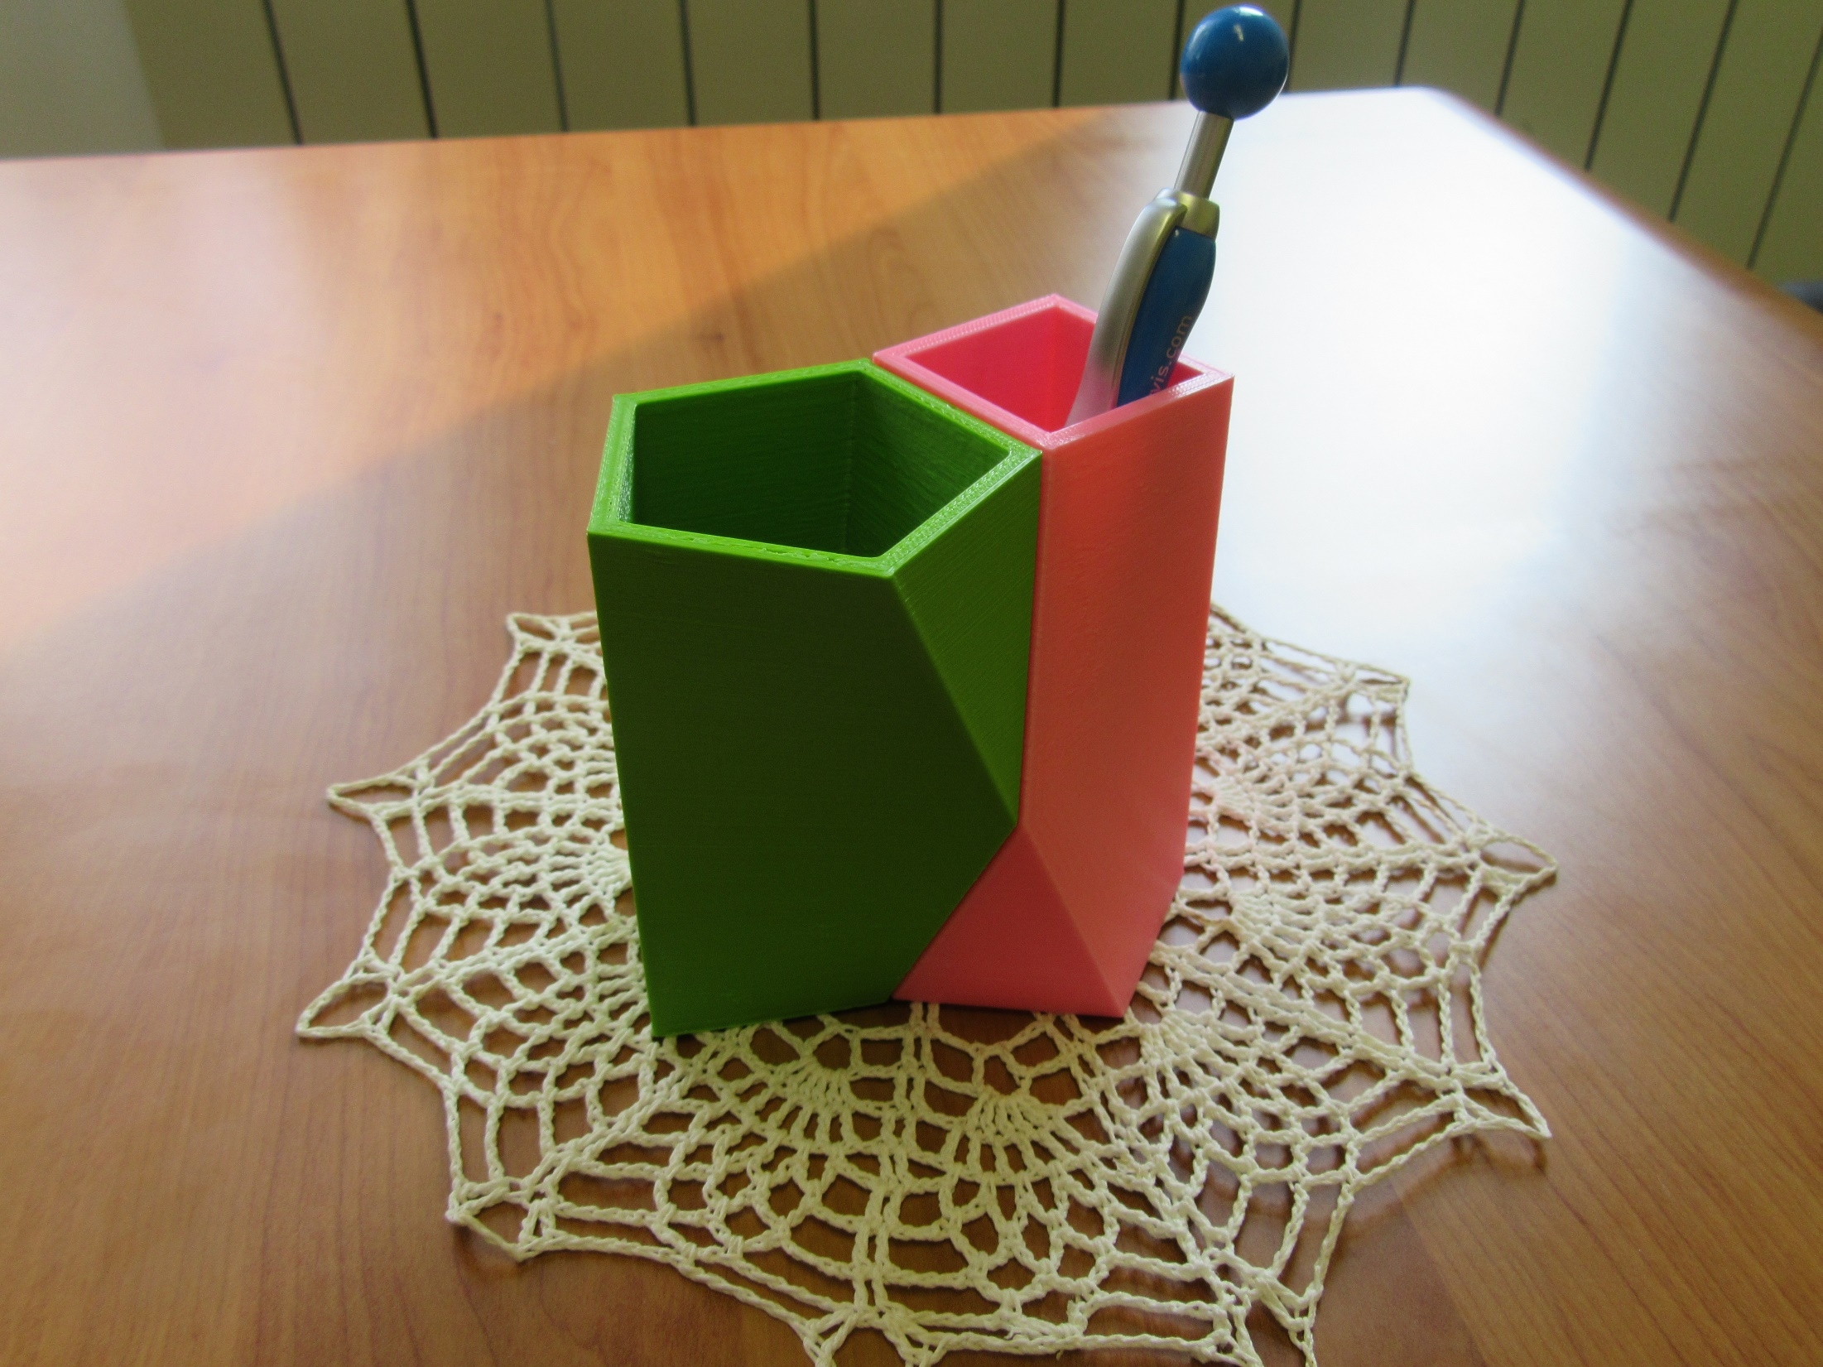

Slide 39
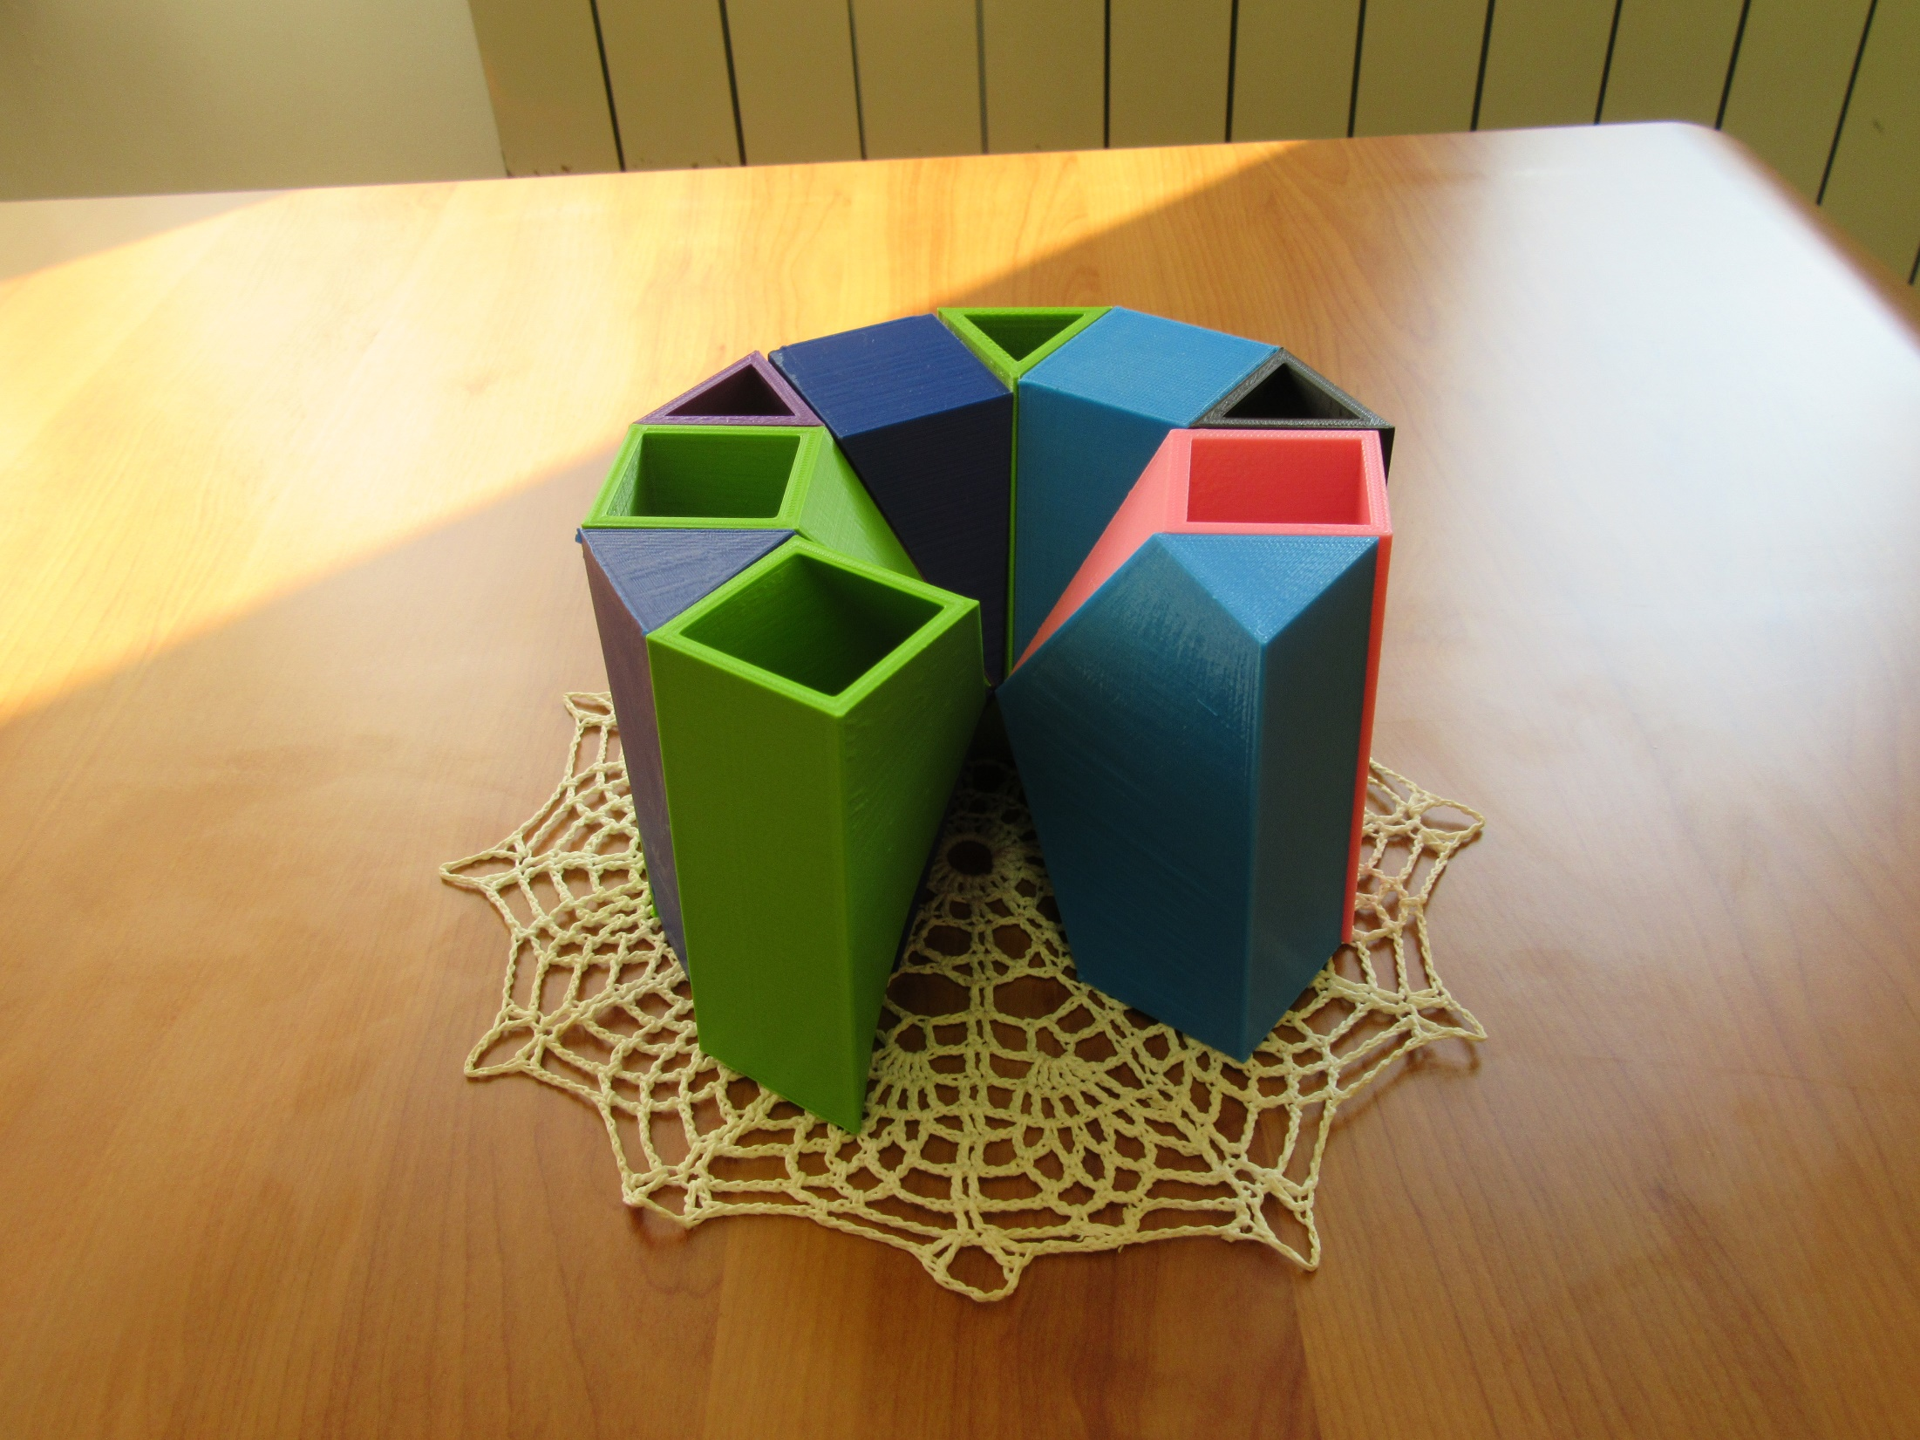

Slide 40
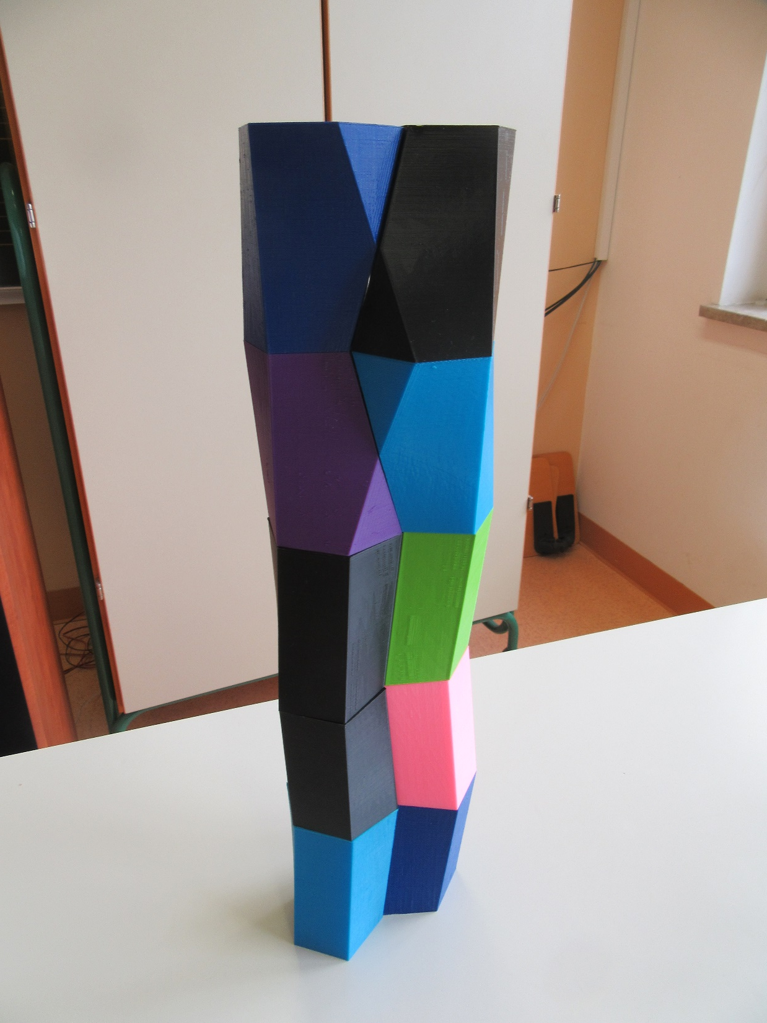

Slide 41
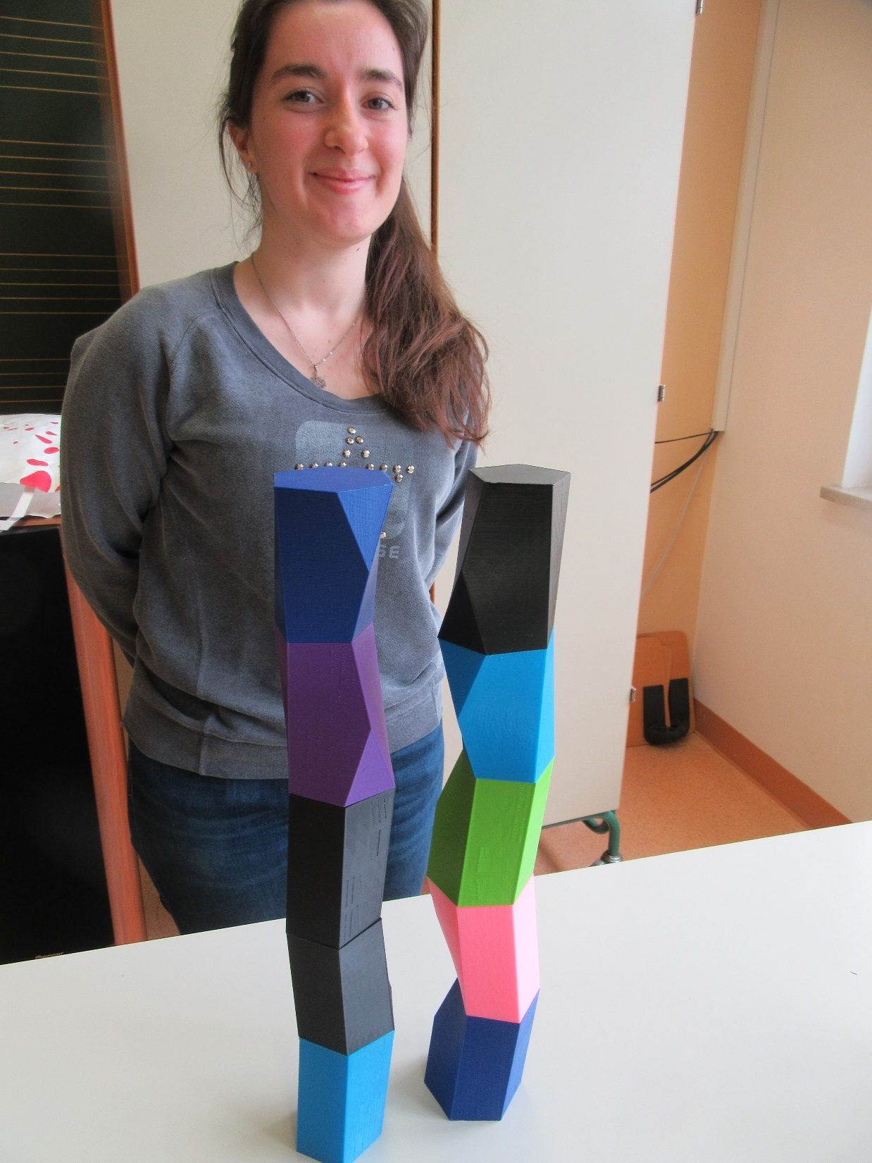

Slide 42
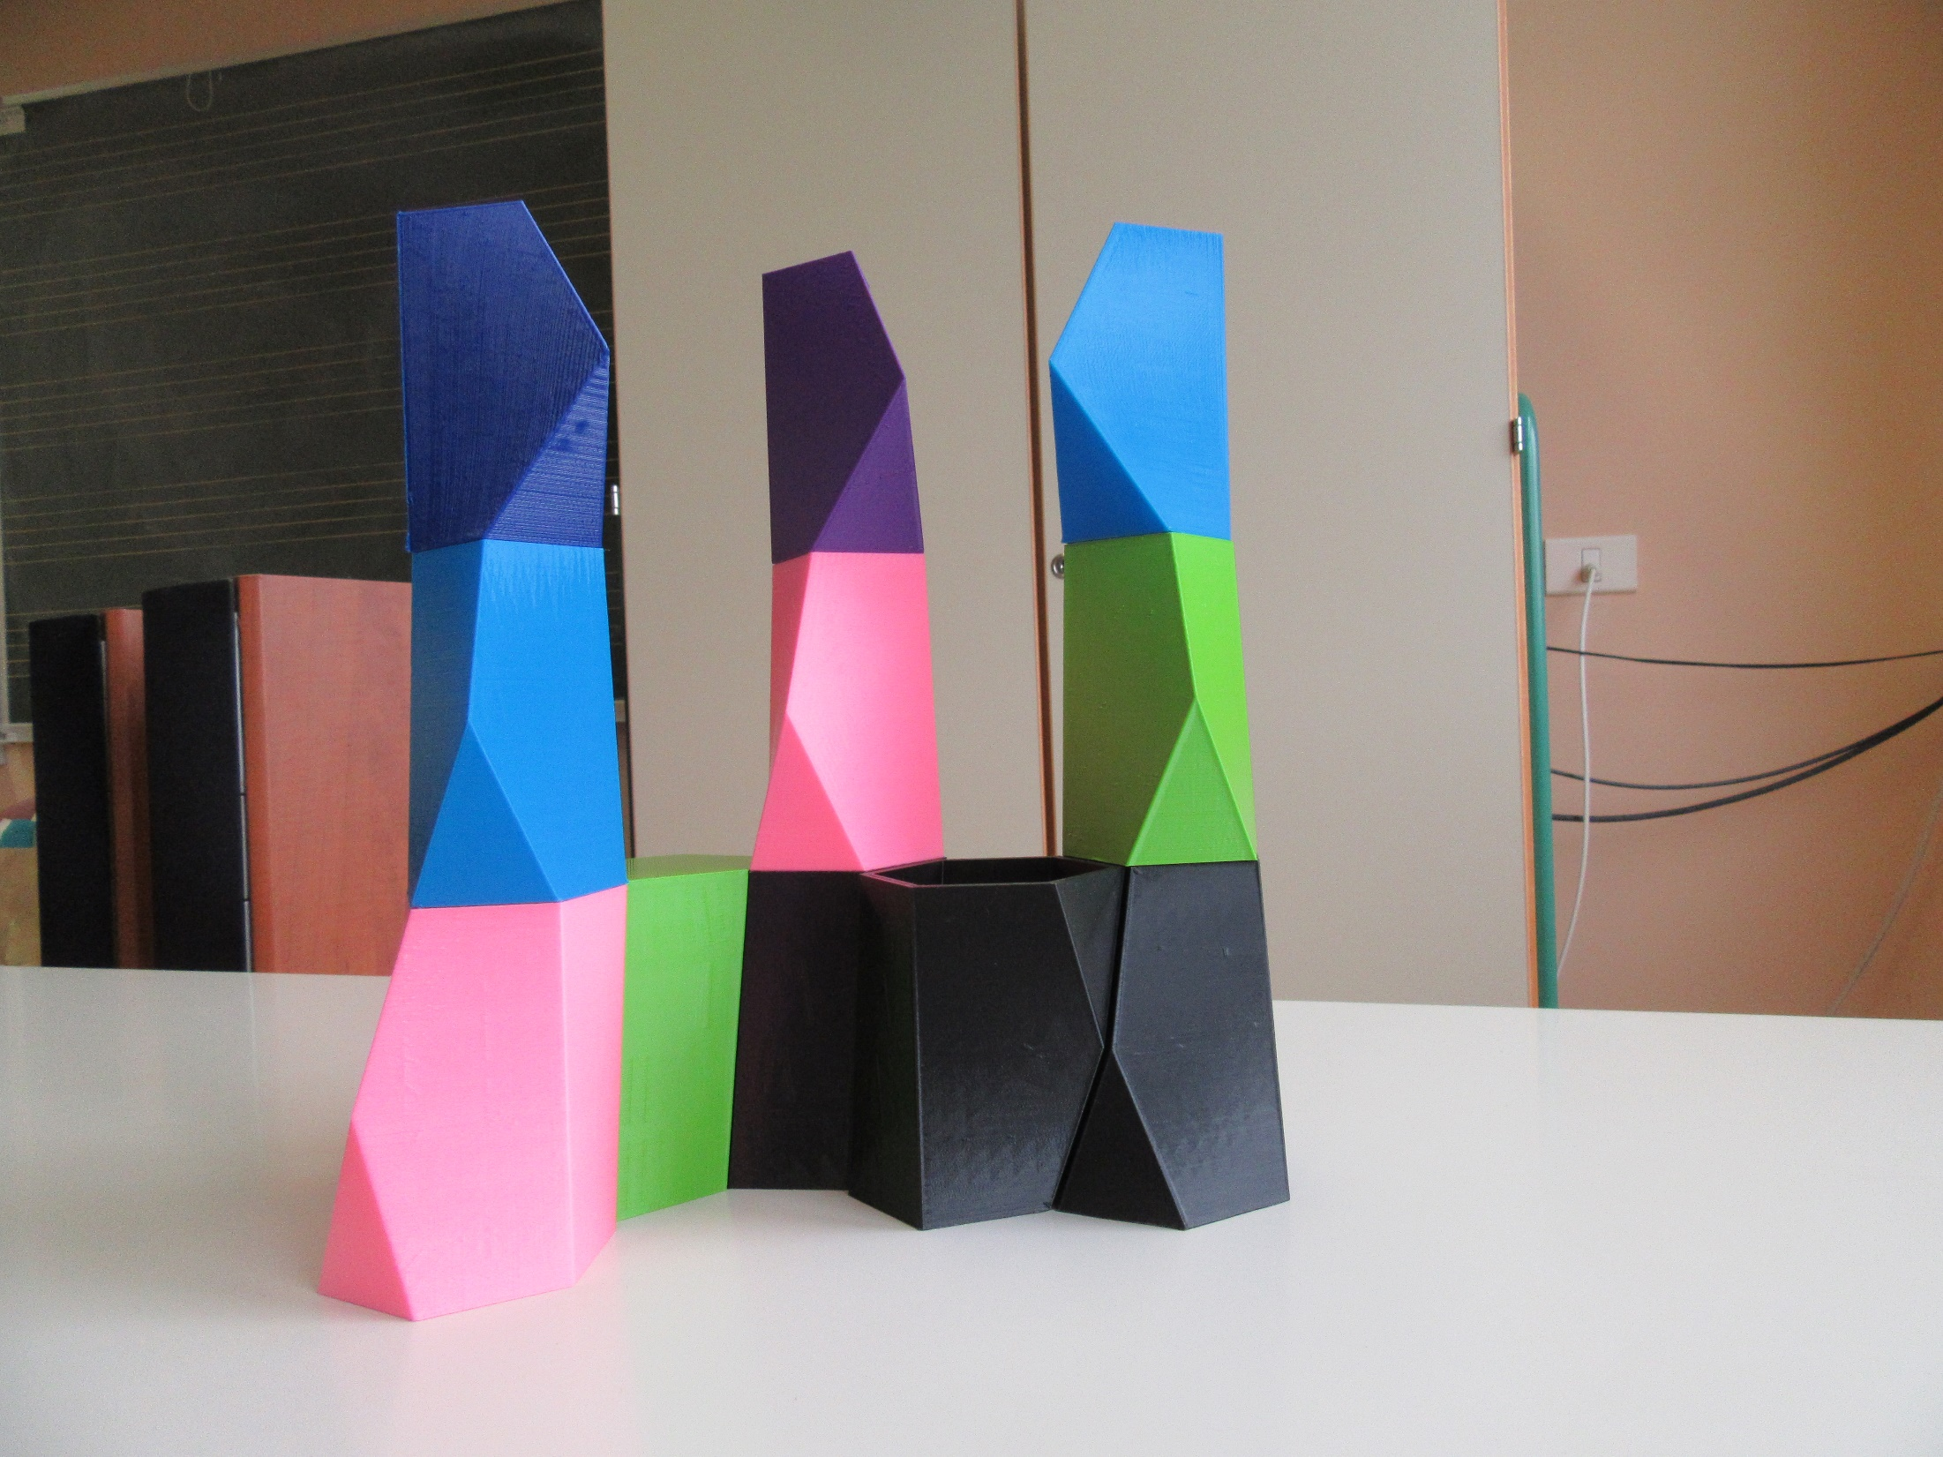

Slide 43
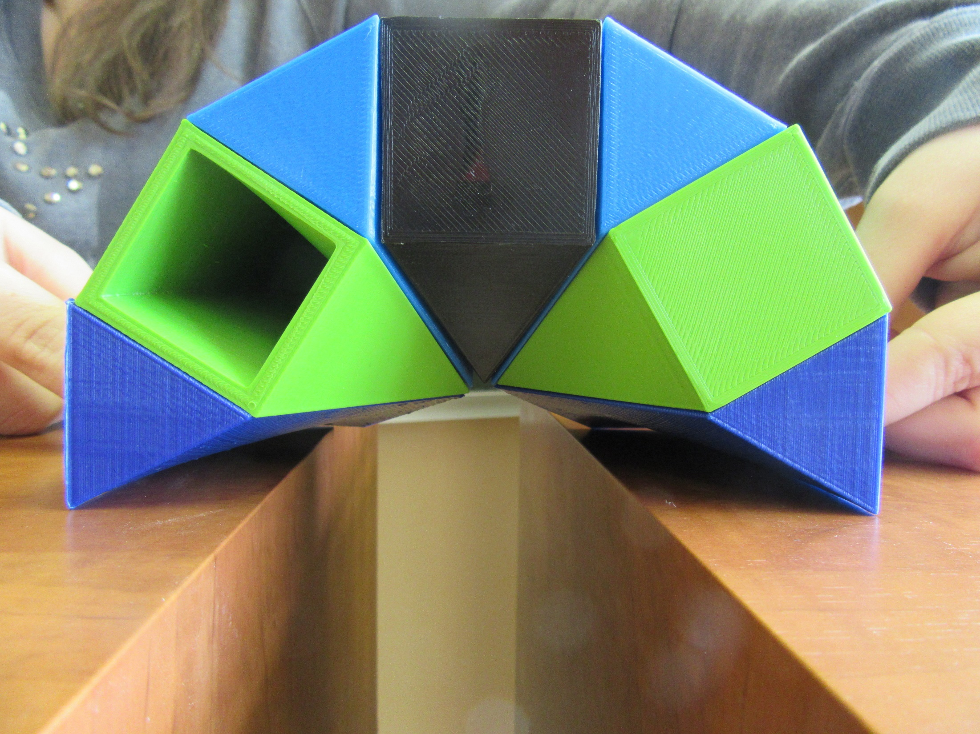

Slide 44
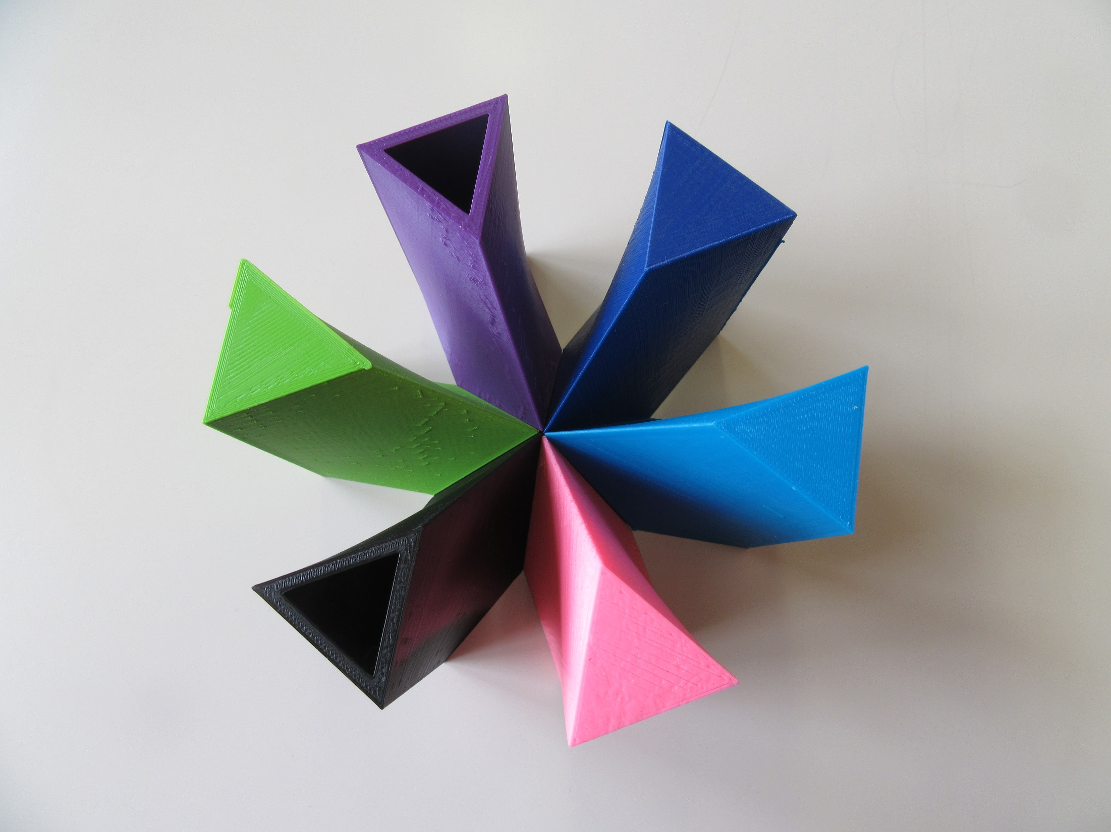

Slide 45
ACTIVITIES FOR CHILDREN (Set: two of 3-4, two of 45, two of 56)
From the multitude of scutoids pick those, who have the same base surface. Name the surface.
Put together the same kind of scutoids, so they combine completely. How many possibilities are there?
Take two sets of scutoids. Form chains of the same scutoids.
Take two sets. Form arches with the same kind of scutoids. In which cases can you make a circle?
Put together the same kinds of scutoids, so they complement each other. Is this even possible?
Take one set. From all three pairs of scutoids build a tower, so two scutoids touch each other with the same base surfaces. Find at least two possibilities.
Form buildings.
Draw the network of scutoids and form a geometric solid.

Slide 46
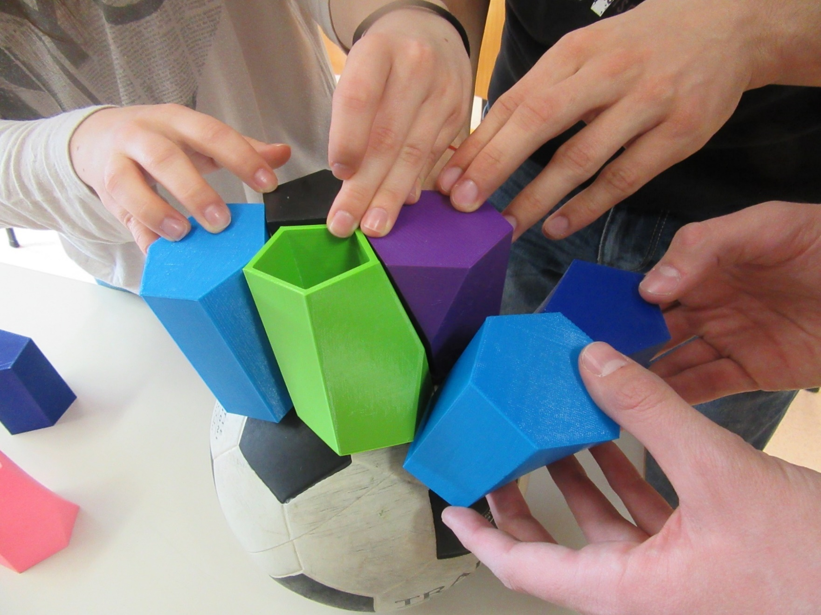
VIEW FORWARD

Slide 47
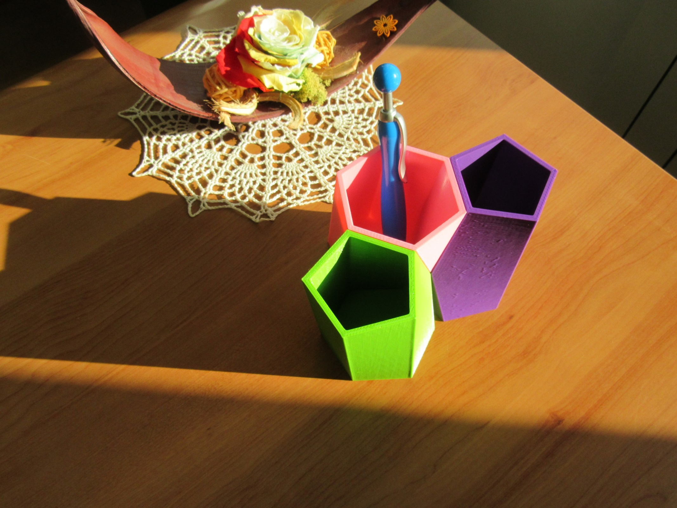
THANK YOU FOR YOUR ATTENTION

